Slide 1

COMPANY PROFILE
Daesan NDE
International Engineering Co., Ltd

Slide 2
Contents
General Information
Company History
Scope of Services
Organizations
Certificate of Management System
Status of Personal Qualification
Equipment List
Performance Records
Certification Status of Inspectors & Equipment
Training & Certification

Slide 3
1. General Information
Company name | Daesan NDE International Engineering
Foundation | October 19, 2017
Authorized Capital | 390,000,000 UZS
Head Office | 62-20, Sergeli 7, Sergeli district, Tashkent, Uzbekistan
Our Partners | NDE: SYMITech (Kor) PWHT: Daesan Plant (Kor)
Contacts | Tel: +998-90-941-4093 E-mail: jung691102@hanmail.net contact@daesannde.com
Website | https://daesannde.com

Slide 4
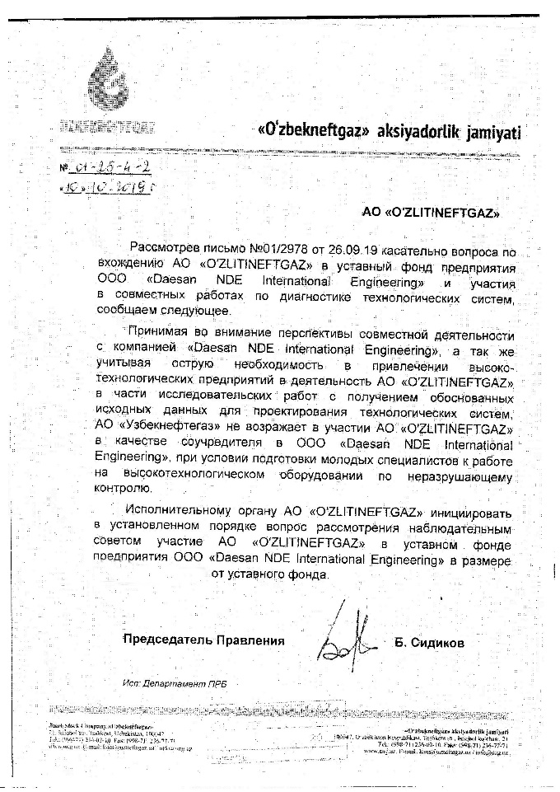


2. Company History
Joint Venture
NDT Technical Personnel
NDT Education & Training
Special Inspection
(PMI, Videoscope, etc)
4

Slide 5
2. Company History
2019
Converted to a Joint Venture with following companies
- JSC "O'ZLITITINGNEFT'GAZ"
- SamYoung Material Inspection Technology Co., Ltd
- DAESAN NDE INTERNATIONAL ENGINEERING Co., Ltd
2018
Acquired ISO/IEC 17025:2007 Accreditation from NAPM No. UZ-TK TL.0017 (UZ.AMT.07.MAI.1180)
Acquired permission to use NDT laboratory.
Acquired permission to use radiation isotope. (UZ)
2017
Established Daesan NDE International Engineering Co., Ltd.

Slide 6






3. Scope of Services
Radiographic Test
PWHT
Leak Test
Eddy Current Test
Thermal Infrared Test
Maintenance
Manufacture
Welding Inspection
Storage tank Inspection
Bridge Inspection
Consulting(system)
Component analysis
Ultrasonic Test
Phased Array Ultrasonic Test
Magnetic Particle Test
Penetrant Test
Visual Test

Slide 7
5. Organizations
General Director
Institutes
Executive
Technical
Q/A
Inspection
Research support
Technical development
Accounts department
Administrative office
Purchase department
Safety management
Management of technique
Business management
Training management
Planning quality
Qualification management
Quality Audit
Inspection
Supervision
NDT
PWHT
RT UT
MT PT
VT PMI
PWHT
Hardness Test
JOB SITE

Slide 8
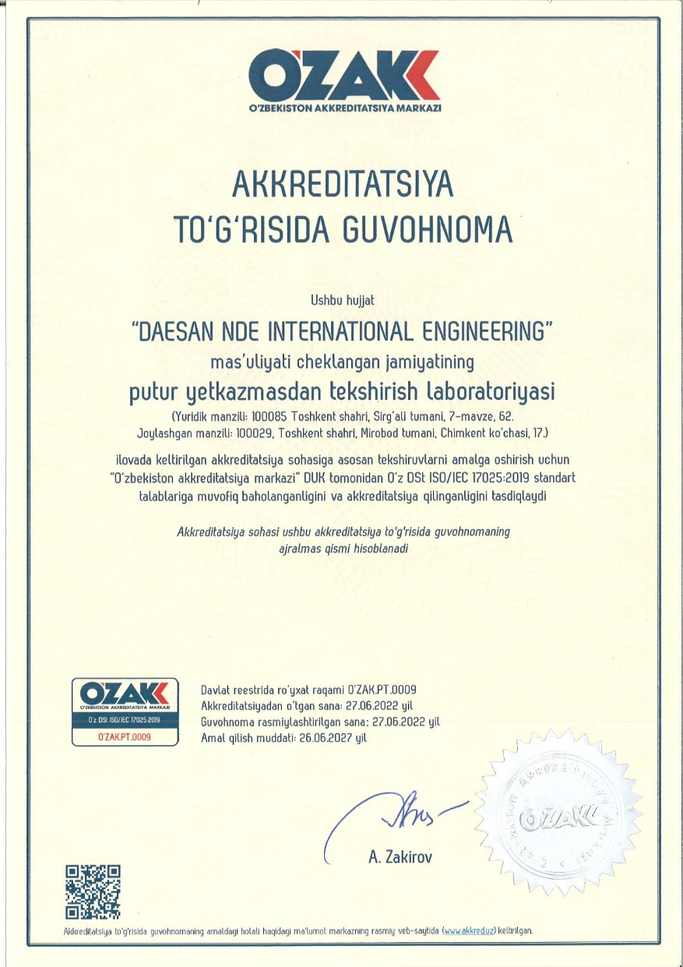
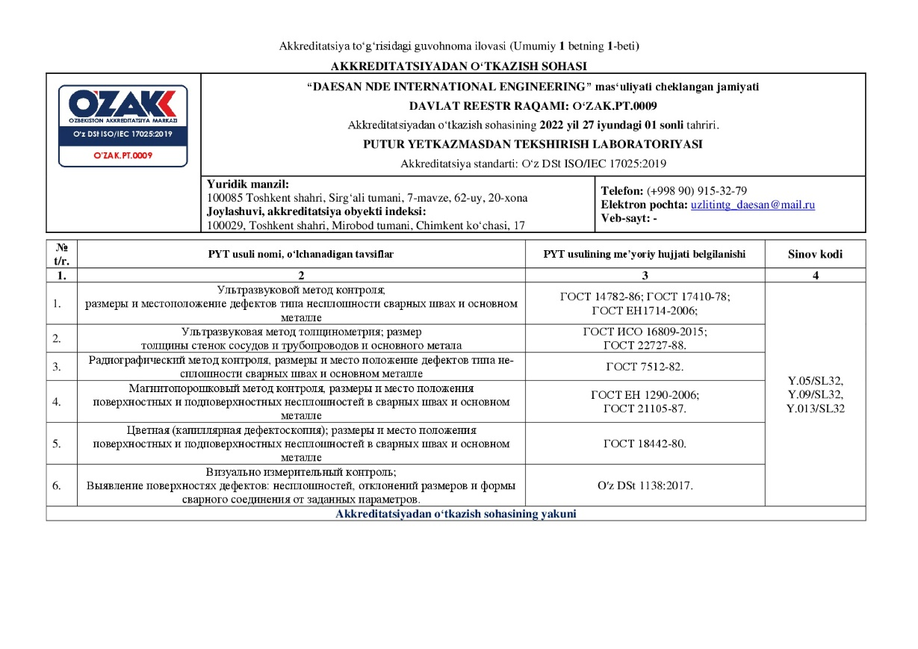
5. Certificates of Management System
ISO/IEC 17025:2019 Accreditation from NAPM

Slide 9
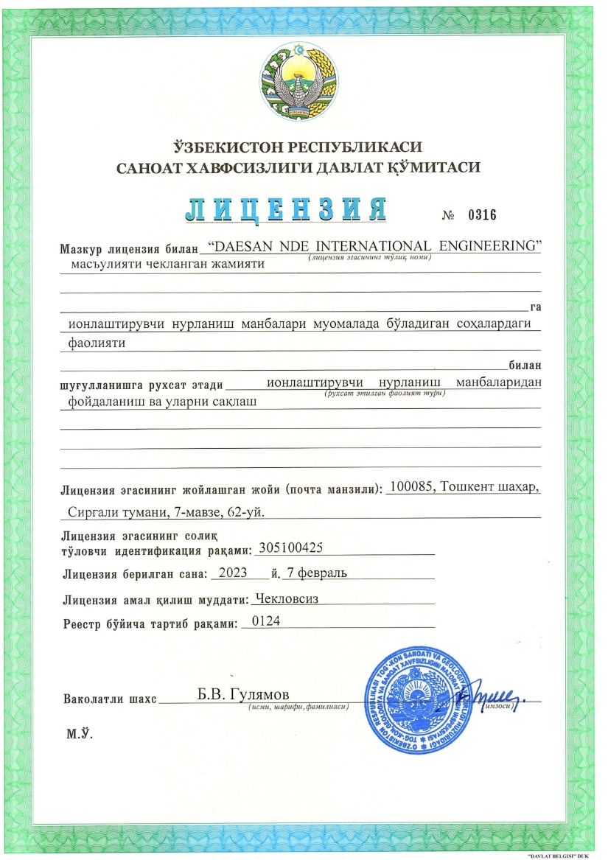
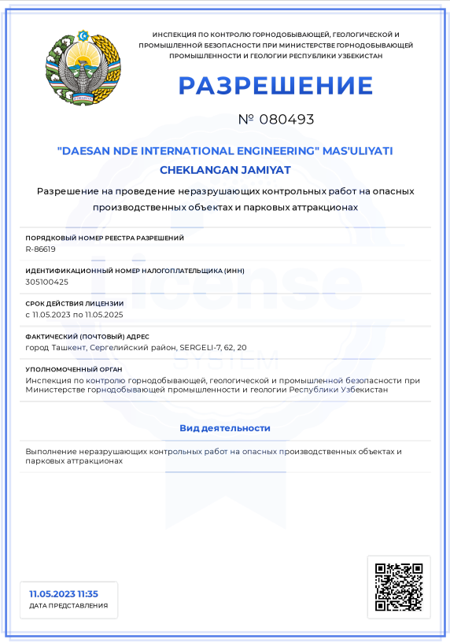
5. Certificates of Management System
Permission to perform non-destructive testing
at hazardous production facilities
Permission to store and use ionizing radiation sources

Slide 10
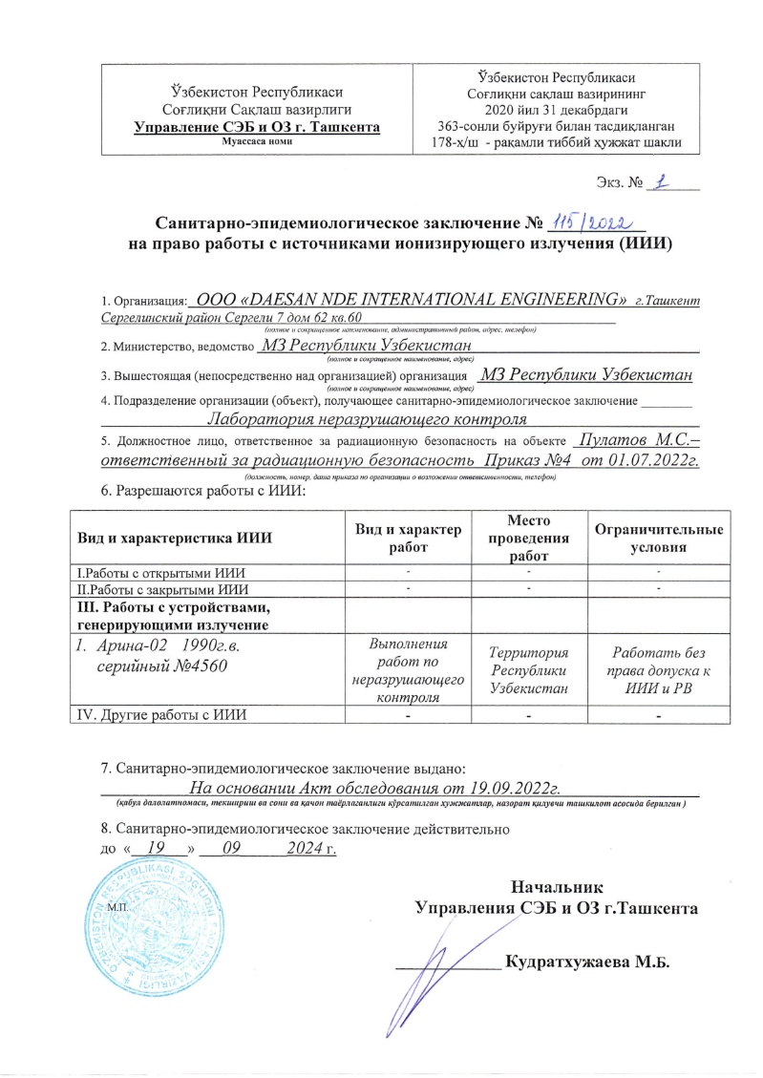
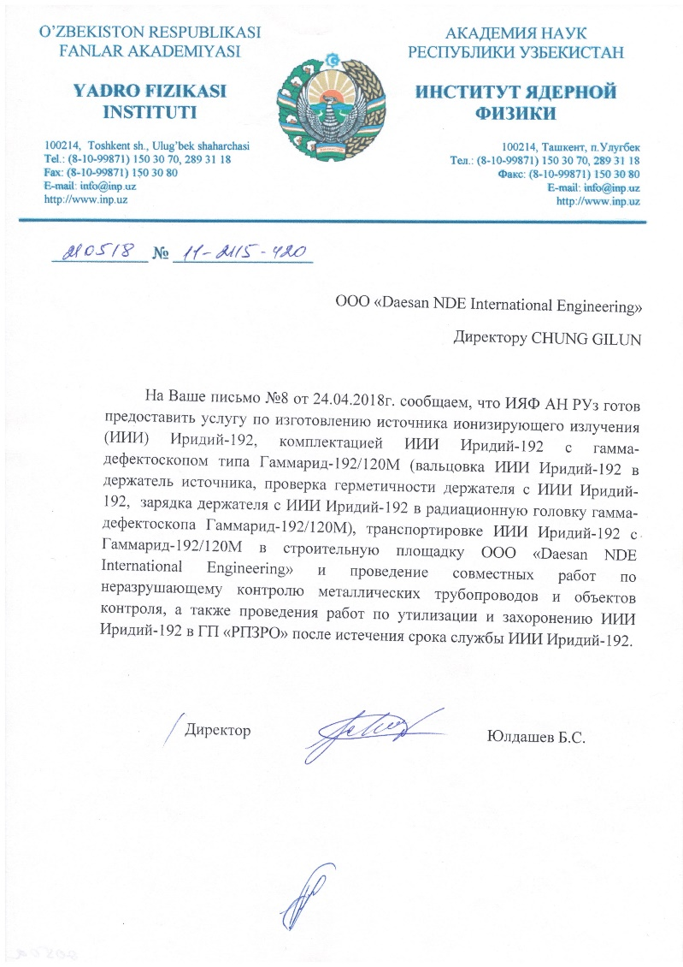
5. Certificates of Management System
Radiation service provision Agreement
Epidemiological conclusion on the right to work with sources of ionizing radiation

Slide 11
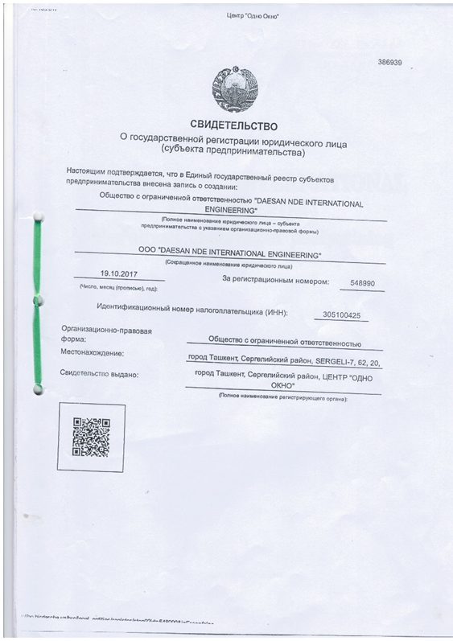
5. Certificates of Management System
Certificate of State registration of a legal entity

Slide 12
6. Status of Personal Qualification
Daesan NDE International Engineering Co., Ltd
Grade/Method | RT | RI | MT | PT | UT | PAUT | TOFD | CSWIP | VT | PW HT | Total
UZ SMT Level III | 1 | 1 | 1 | 1 | 1 |  |  |  | 1 |  | 6
UZ SMT Level II | 6 |  | 2 | 2 | 3 |  |  |  |  |  | 13
ASNT Level III | 2 |  | 1 | 1 | 2 |  |  |  |  |  | 6
ASNT Level II
ISO9712 Level III | 2 |  | 2 | 1 | 1 | 1 | 1 | 1 |  |  | 9
ISO9712 Level II |  |  |  |  |  | 2 | 2 | 1 |  |  | 5
PWHT High Technician |  |  |  |  |  |  |  |  |  | 2 | 2
PWHT Technician |  |  |  |  |  |  |  |  |  | 4 | 4

Slide 13
6. Status of Personal Qualification
Daesan
Body | Cert & Grade | All | RT | UT | MT | PT | ECT | LT | VT
HRDK | NDT Sr. Engineer NDT Jr. Engineer NDT Technician |  | 6 1 12 | 6 2 9 | 8 4 12 | 15 2 11 | 4 | 3
ASNT | ASNT NDT LEVEL III |  | 7 | 6 | 6 | 2 |  |  | 2
SYMITech (INHOUSE) | NDE LEVEL III NDE LEVEL II NDE LEVEL I |  | 8 29 | 8 29 | 8 29 | 8 29 |  |  | 3 7
MOST | RI Supervisor License RI General License | 2 6
NAS410 | NDT LEVEL 3 NDT LEVEL 2 |  | 1 13 | 1 4 | 1 14 | 1 15
ISO 9712 | NDT LEVEL 2 | 5 | 2 | 2 | 1

Slide 14
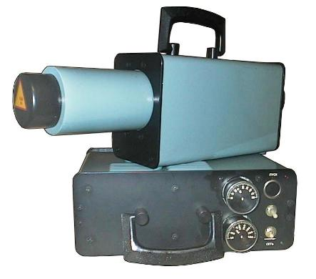
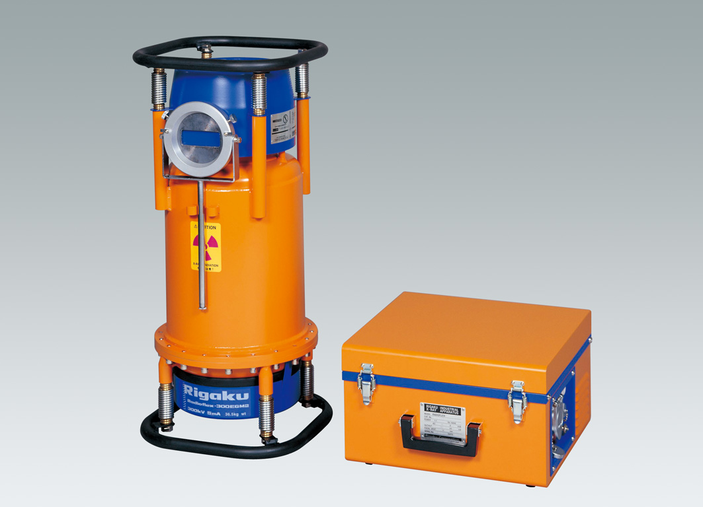
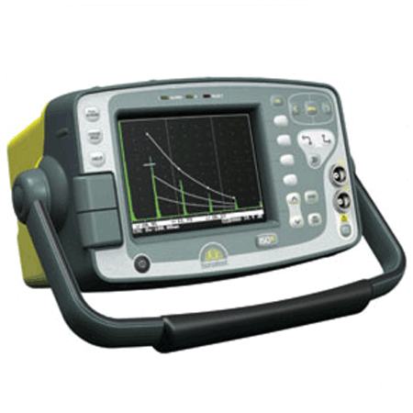
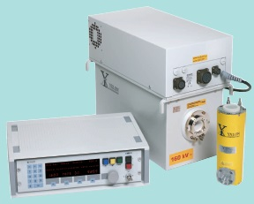
7. Equipment List
Radiographic Testing
 | Item | Type | Model | Q’ty | RM
 | X-ray | 300Kvp | - | 3 | Daesan NDE International Engineering (DNIE)
 | X-ray | 300Kvp / 5mA | RIGAKU | 5 | DNIE
 | X-ray | 225Kvp / 5mA | YXLON | 2 | DNIE

Slide 15
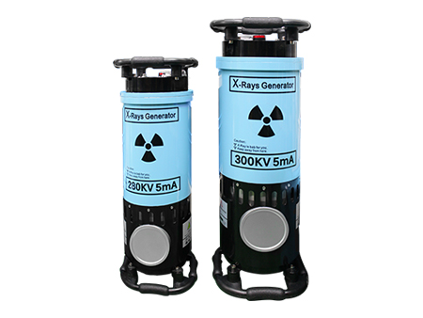
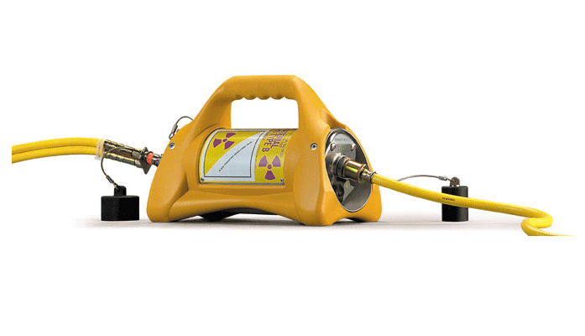
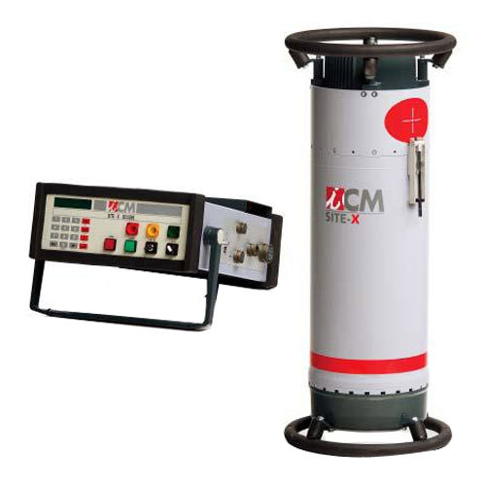
7. Equipment List
Radiographic Testing
 | Item | Type | Model | Q’ty | RM
 | X-ray | 300Kvp / 5mA | RONGTAN | 3 | DNIE
 | X-ray | 250Kvp / 5mA | ICM | 2 | DNIE
 | γ-ray | 120Ci | 880 Delta | 6 | DNIE

Slide 16
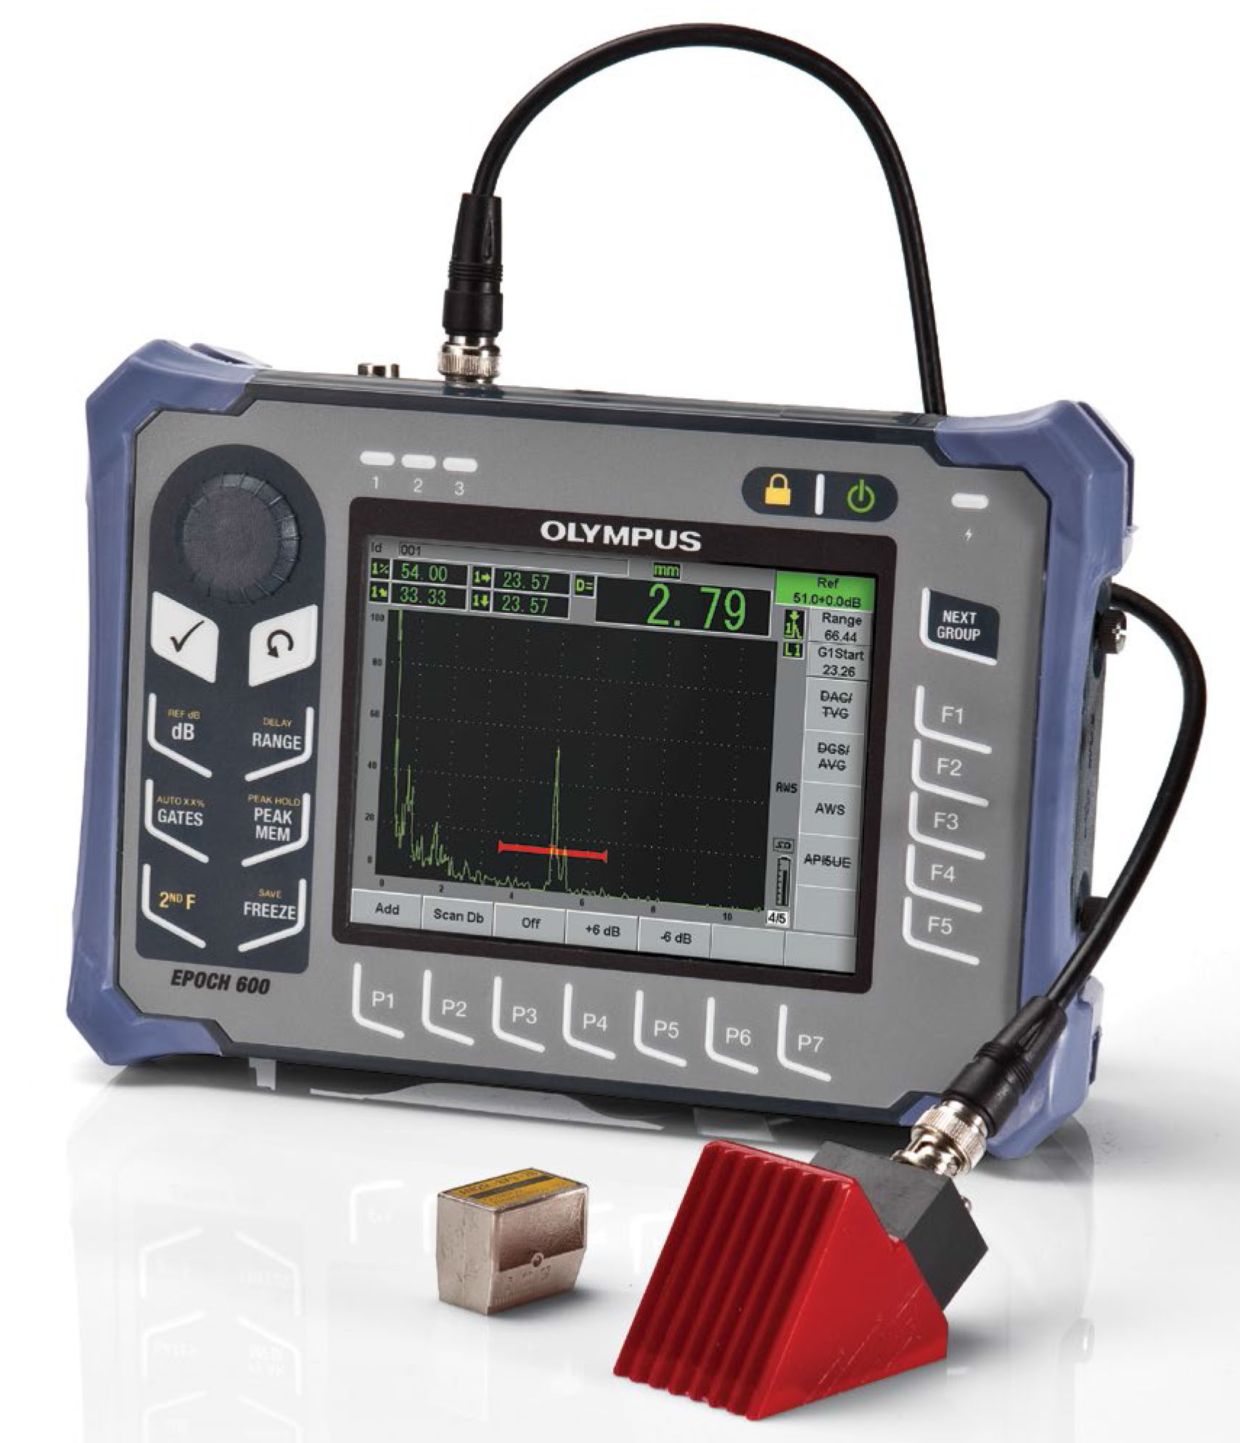
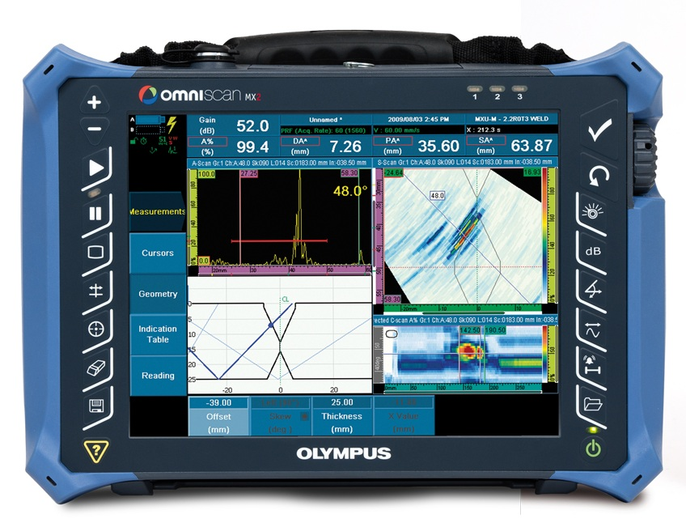
7. Equipment List
Ultrasonic Testing
 | Item | Maker | Model | Q’ty | RM
 | Ultrasonic Testing Instruments | SONATEST OLYMPUS | SS -150 EPOCH’s | 37 11 | DNIE
 |  | OLYMPUS | EPOCH 600 | 2 | DNIE
 | PAUT | Olympus/ SIUI | MX2/ SUPER | 2 1 | DNIE

Slide 17
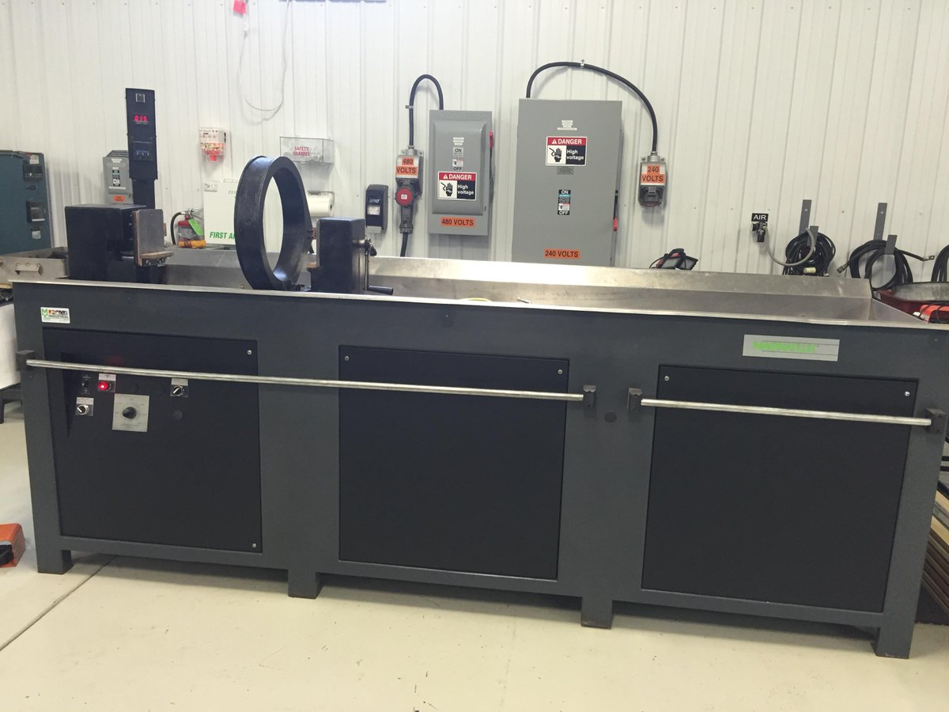
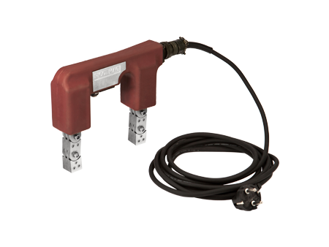
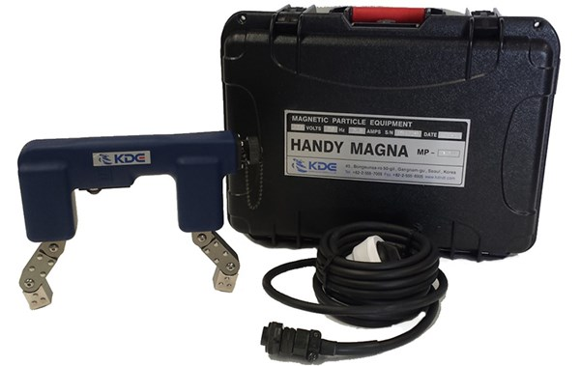
7. Equipment List
Magnetic Particle Testing
 | Item | Maker | Model | Q’ty | RM
 | Magnetic Particle Testing (system) | KyungDo Enterprise Magnaflux NDTech | MS6000 D-960LR MD3-1060 PE-XY300M | 2 1 1 1 | SYM.I.T
 | Magnetic Particle Testing | KyungDo Enterprise NAWOO Ltd. | Yoke (Portable) | 40 10 | SYM.I.T
 | Magnetic Particle Testing | NAWOO Ltd. | Yoke (Portable) | 2 | DNIE
17

Slide 18
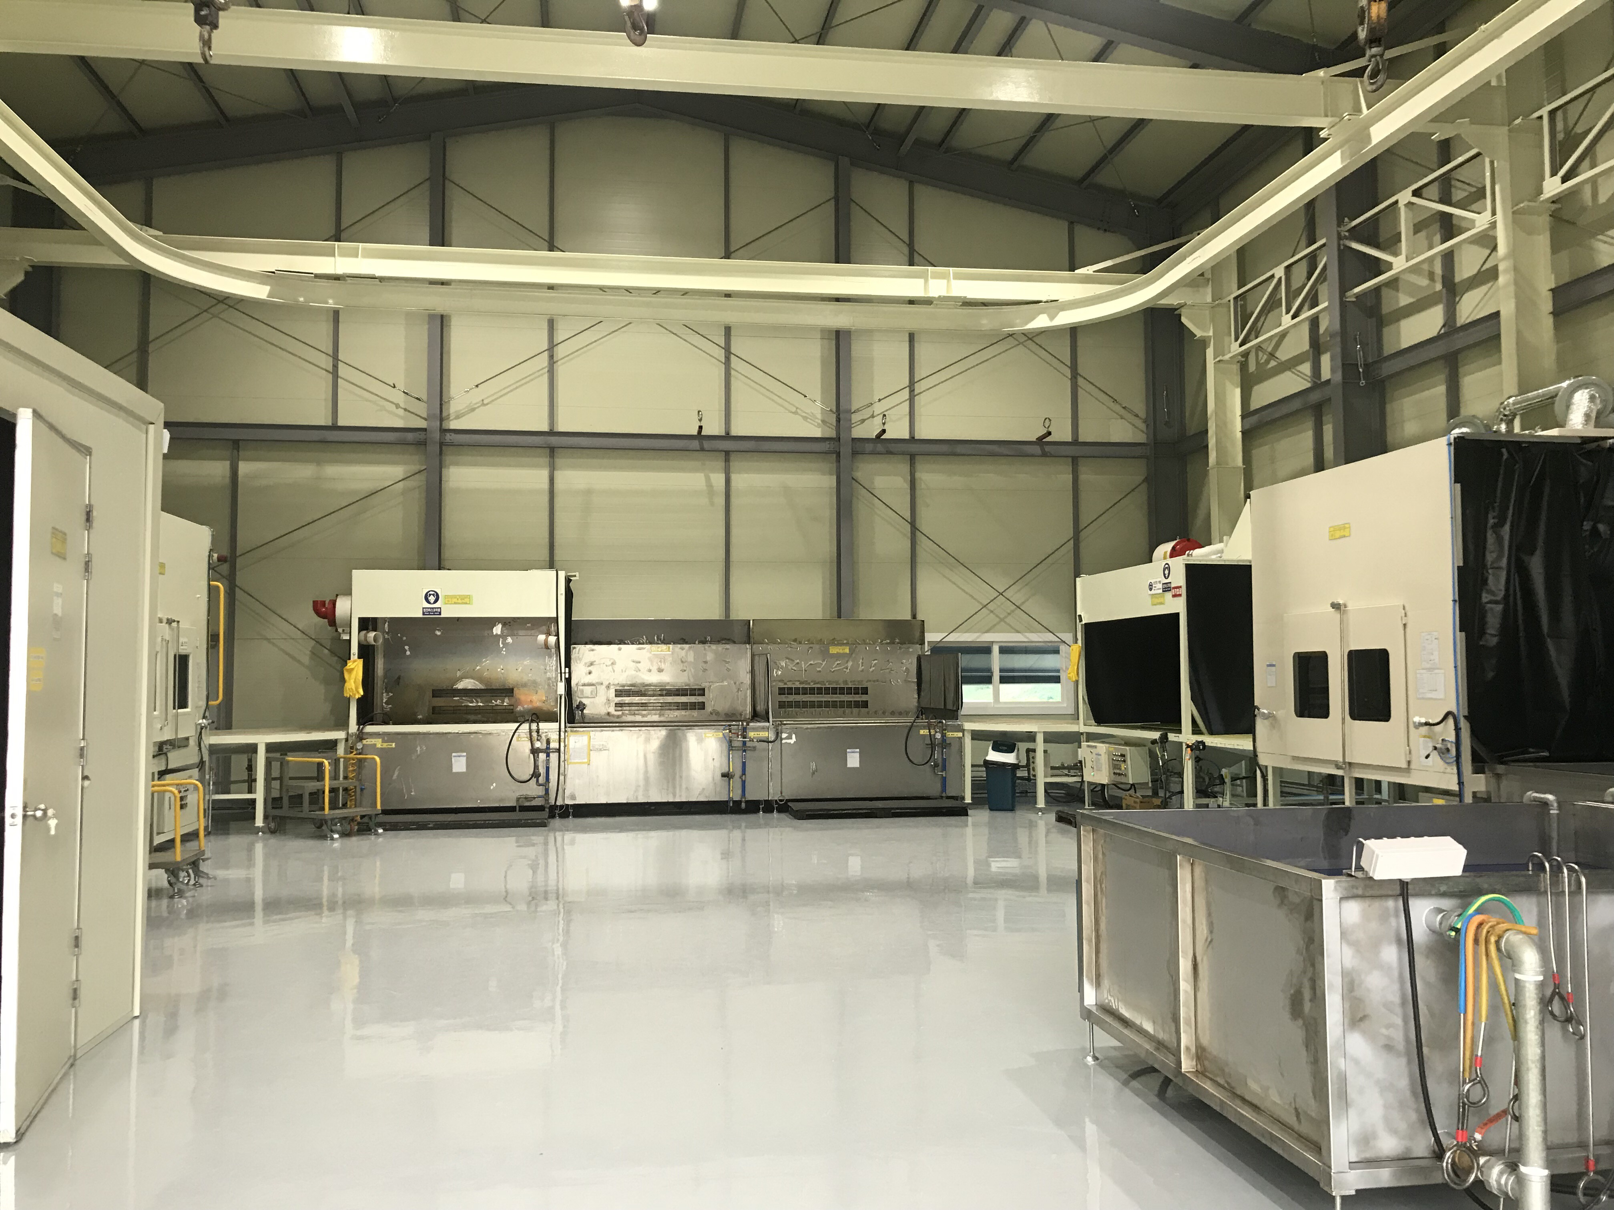
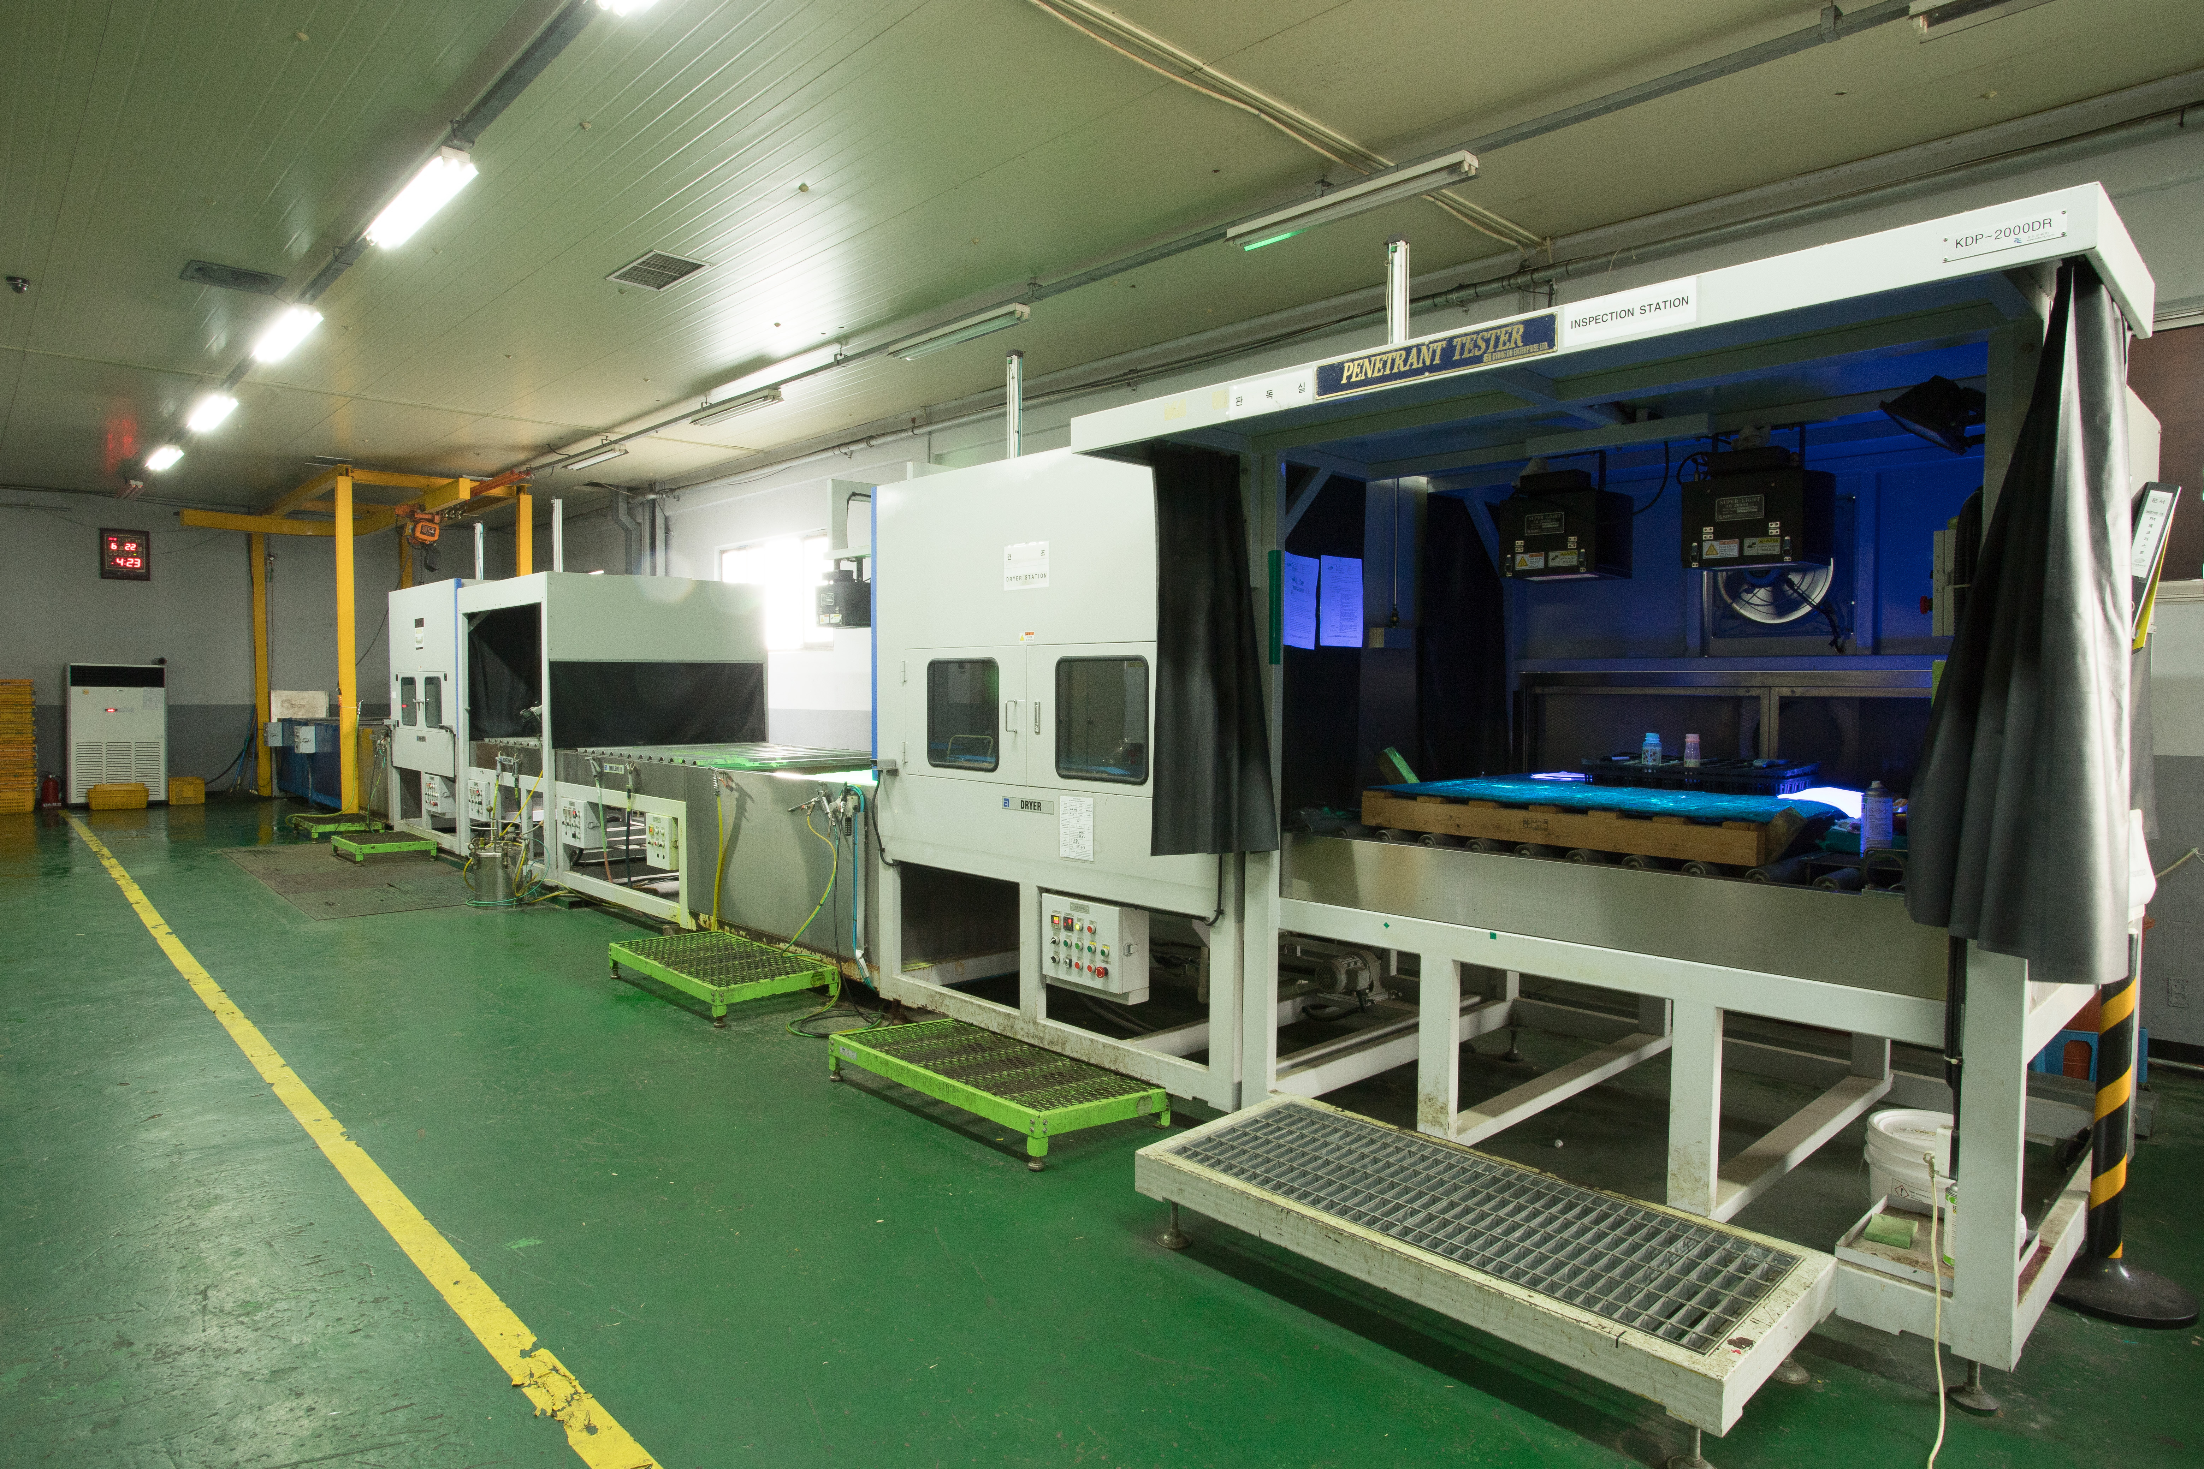
7. Equipment List (SYMITech)
Penetrant Testing
 | Item | Maker | Model | Q’ty | RM
 | Penetrant Testing (system) | KyungDo Enterprise | - | 1 | SYM.I.T
 | Penetrant Testing (system) | RENO | - | 1 | SYM.I.T
18

Slide 19
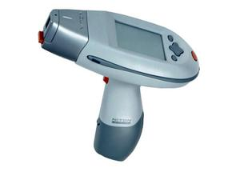
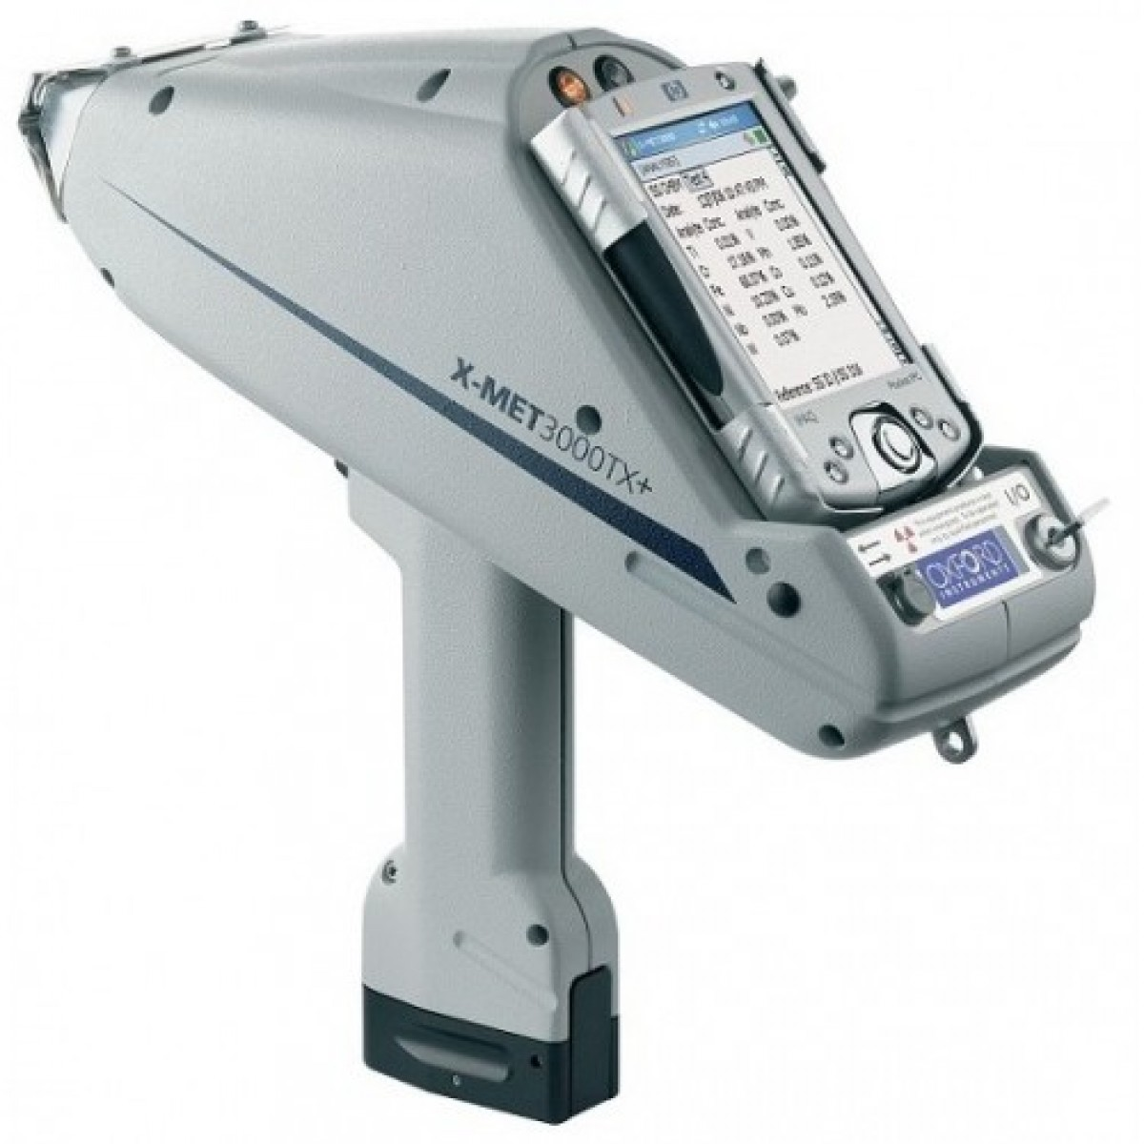
7. Equipment List
Positive Material Inspection
 | Item | Maker | Model | Q’ty | RM
 | PMI Alloy Anaylizer | METOREX NITON | X-MET 3000TX XLI-818 | 1 1 | DNIE
 |  | NITON | XLI-818, XFB-4 | 1 | DNIE
19

Slide 20
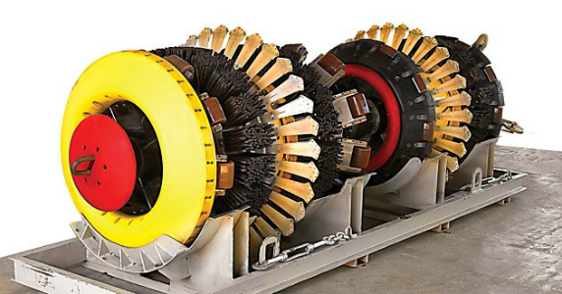
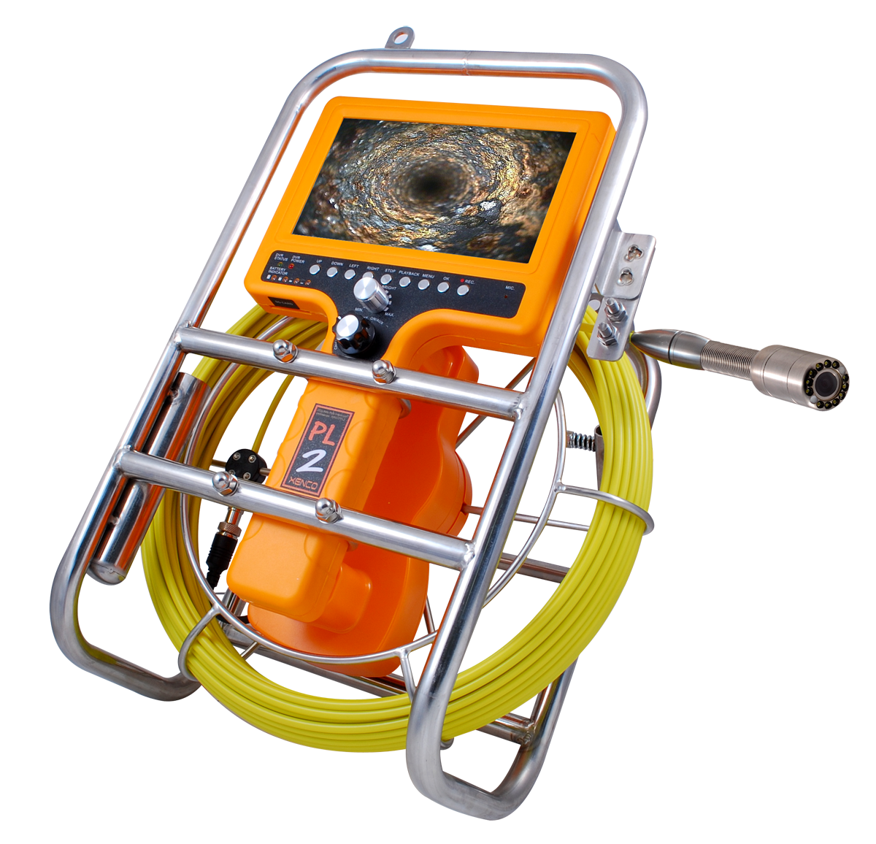
7. Equipment List (SYMITech)
PIPE Inspection
 | Item | Maker | Model | Q’ty | RM
 | PIPE Inspection Borescope | XENCO | XENCO-PL2 | 1 | SYM.I.T
 | IN-LINE INSPECTION | Petro Borhan Bina | Intelligent Pigging | 1 | SYM.I.T
20

Slide 21
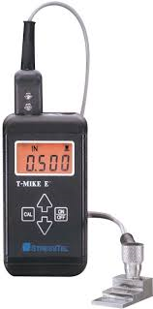
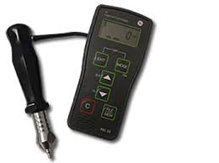
7. Equipment List
Hardness Test
Ultrasonic Thickness Gauge
 | Item | Maker | Model | Q’ty | RM
 | Hardness Tester | GE | MIC series | 9 | DNIE
 | Ultrasonic Thickness Gauge | STRESSTEL | T-MARK E | 1 | DNIE
21

Slide 22
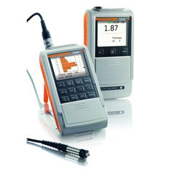
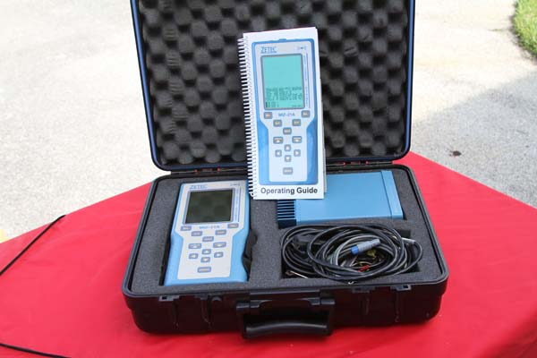
7. Equipment List (SYMITech)
Ferrite Meter
Eddy Current Testing
 | Item | Maker | Model | Q’ty | RM
 | Ferrite Meter | FISCHER | FMP-30 | 3 | SYM.I.T
 | Eddy Current Testing | ZETEC | MIZ-21A | 1 | SYM.I.T
22

Slide 23
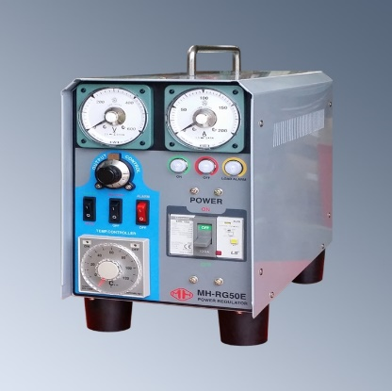
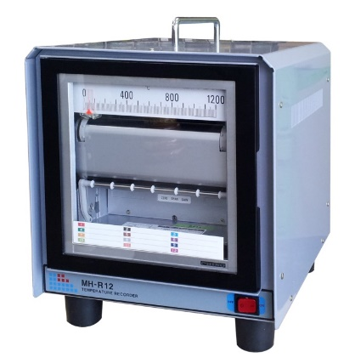
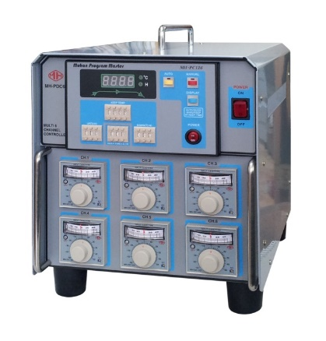
7. Equipment List
PWHT
Item | Model | Maker | Q’ty UNIT | RM
POWER REGULATOR | MH-RG50E & etc. | Muhansys | 1100 | DNIE
TEMPERATURE RECORDER | MH-R12 & etc. | CHINO | 153 | DNIE
TEMPERATURE PROGRAM CONTROLLER | MH-PC126 & etc. | Muhansys | 41 | DNIE
23

Slide 24
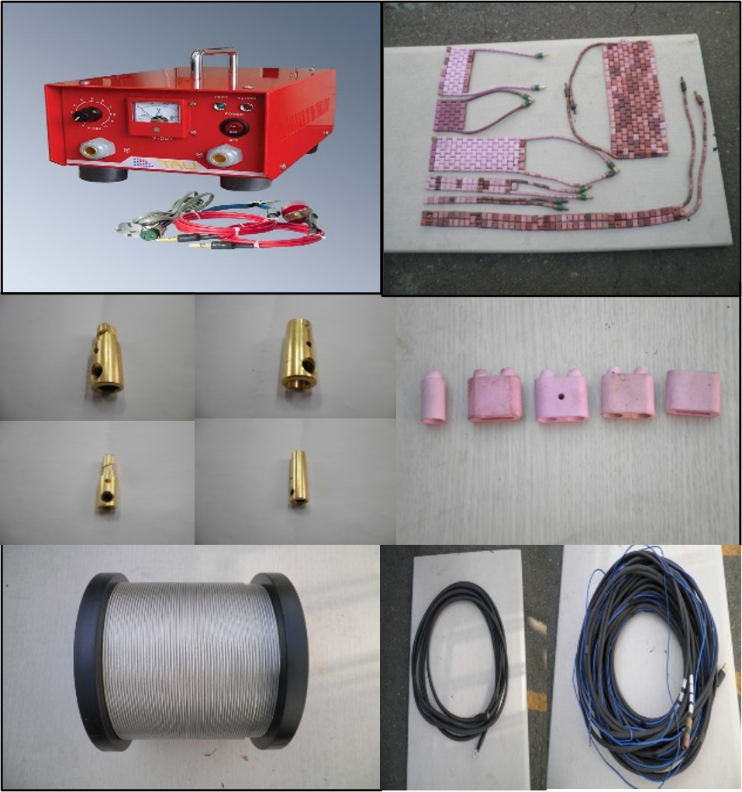
7. Equipment List
PWHT
Item | Q’ty | RM
Thermocouple Attachment Unit | 200 units | DNIE
Heating Pad | 15,000 SET | DNIE
Ceramic Pad | 1,000,000 EA | DNIE
Cam Lock 300A, 60A | 10,000 EA | DNIE
Ni-Cr Wire | 10,000 M | DNIE
In, Output Cable | 420,000 M | DNIE
24

Slide 25
8. Performance Records (DNIE)
Uzbekistan
Project Name | Customer | Methods
Safety Inspection of Tank | BINOKOR TEMIR BETON SERVIS | RT,UT,MT,PT,VT
Safety Inspection of Crane | BINOKOR TEMIR BETON SERVIS | UT,MT,PT,VT
Safety Inspection of Children’s Park | UZEXPO CENTER | UT,MT,PT,VT
Safety Inspection of Pipe-line | ANDIJON NEFT | RT,UT,MT,PT,VT
Safety Inspection of equipment | CNLC | UT,MT,PT,VT
25

Slide 26
8. Performance Records (DNIE)
Uzbekistan
Project Name | Customer | Methods
Safety Inspection of equipment | Institute of Nuclear Physics | UT,MT,PT,VT
Safety Inspection of equipment | China Petroleum Logging Co.Ltd | UT,MT,PT,VT
Safety Inspection of equipment | MUBAREK Oil and Gas Production Department (UNG) | UT,MT,PT,VT
Non-Destructive Testing for the construction of SIRDARYA TPP CCGT 1500 MW | CHINA GEZHOUBA GROUP INTERNATIONAL ENGINNERING CENTRAL ASIA | RT, PAUT, UT,MT,PT,VT
Safety Inspection of equipment | Bomi Enginnering Construction Co.,Ltd | UT,MT,PT,VT
26

Slide 27
8. Performance Records (DNIE)
Uzbekistan
Project Name | Customer | Methods
Safety Inspection of equipment | MUBAREK Gas Processing Plant (UNG) | UT,MT,PT,VT
Safety Inspection of equipment | “UCHKIR” (UNG) | UT,MT,PT,VT
Safety Inspection of equipment | USTURT GPD (UNG) | UT,MT,PT,VT
Safety Inspection of equipment | SHURTAN OGPD (UNG) | UT,MT,PT,VT
Safety Inspection of equipment | SHANGHAI CONTRUCTION GROUP CO.LTD | UT,MT,PT,VT
Safety Inspection of equipment | Calik Enerji Sanayive T.A.S. Navoi2 | RT,UT,MT,PT,VT
27

Slide 28
8. Performance Records (SYMITech)
NDT Career | Project Name | Customer | Methods | Item
Chemical Plant | Korea Petrochemical Onsan Plant Industrial Facility | GS Caltex | RT, UT, MT, PT | PIPE (Welding)
 | Iran NGL 3200 | Doosan Heavy Industry | RT, UT, MT, PT, PMI | PIPE, VESSEL (Welding)
Generating Unit | Barakah | Doosan Heavy Industry | RT, UT, MT, PT | VESSEL (Welding)
 | New Bo-Ryung thermal power plant | Doosan Heavy Industry | RT, UT, MT, PT | Turbine Blade
Aerospace | MTU Aeroengine | Hanwha Aerospace | RT | Engine Parts (Welding)
 | KSLV-Ⅱ | KAI | RT, PT | Fuel Tank (Welding)
Military | K-21, K-9, K-55 | Hanwha Defense | RT, UT, MT, PT | Defense Parts
 | T-50, KFX | KAI | RT, UT, MT, PT, PAUT | Aircraft Parts
28

Slide 29
8. Performance Records (DAESAN PLANT)
Project Name | Customer | Methods | Periods
PDC Drillship #5 | Samsung Heavy Industries | PWHT | 2010
Ocean Rig Drillship |  | PWHT | 2010
Maersk Drillship |  | PWHT | 2010
PDC Drillship |  | PWHT | 2010
Ocean Rig Drillship |  | PWHT | 2011
Seadrill Drillship |  | PWHT | 2011
Searankers Drillship |  | PWHT | 2011
Ensco Drillship |  | PWHT | 2011
Pacific Drillship |  | PWHT | 2012
Shell prelude FLNG |  | PWHT | 2012
Inpex ichthys |  | PWHT | 2012
HESS TLP |  | PWHT | 2012
EGINA FPSO |  | PWHT | 2013
Egina FLNG |  | PWHT | 2013
Prelude FLNG |  | PWHT | 2013
Stemped TLP |  | PWHT | 2013
Appomattox FPU |  | PWHT | 2013
29

Slide 30
8. Performance Records (DAESAN PLANT)
Project Name | Customer | Methods | Periods
TOTAL FPSO Topside | Daewoo Shipbuilding & Marine Engineering | PWHT | 2010
TMT Drillship |  | PWHT | 2010
Rwei Seabreeze II |  | PWHT | 2010
SSV Drilling Rig |  | PWHT | 2010
Odebrecht Drillship |  | PWHT | 2011
EXXON GBS Topside |  | PWHT | 2011
EXXON Chayvo OPF |  | PWHT | 2011
C.Roffen Container ship |  | PWHT | 2011
SSV CATARINA Drilling Rig |  | PWHT | 2012
TOTAL CLOV FPSO |  | PWHT | 2012
CHEVRON South Nemba |  | PWHT | 2012
Peter Schelte |  | PWHT | 2013
CMA Container ship |  | PWHT | 2013
CHEVRON Wheatstone |  | PWHT | 2013
APMM Container ship |  | PWHT | 2013
Atwood Drillship |  | PWHT | 2013
EXXON Arkutundagi |  | PWHT | 2014
GBS Topside |  | PWHT | 2014
INPEX Ichthys FPSO |  | PWHT | 2014
TMP Drillship |  | PWHT | 2015
Petronas FLNG |  | PWHT | 2015
30

Slide 31
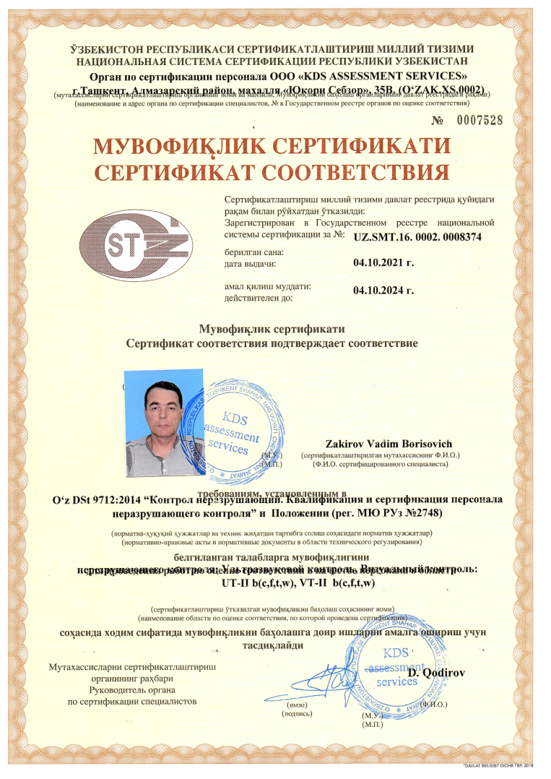
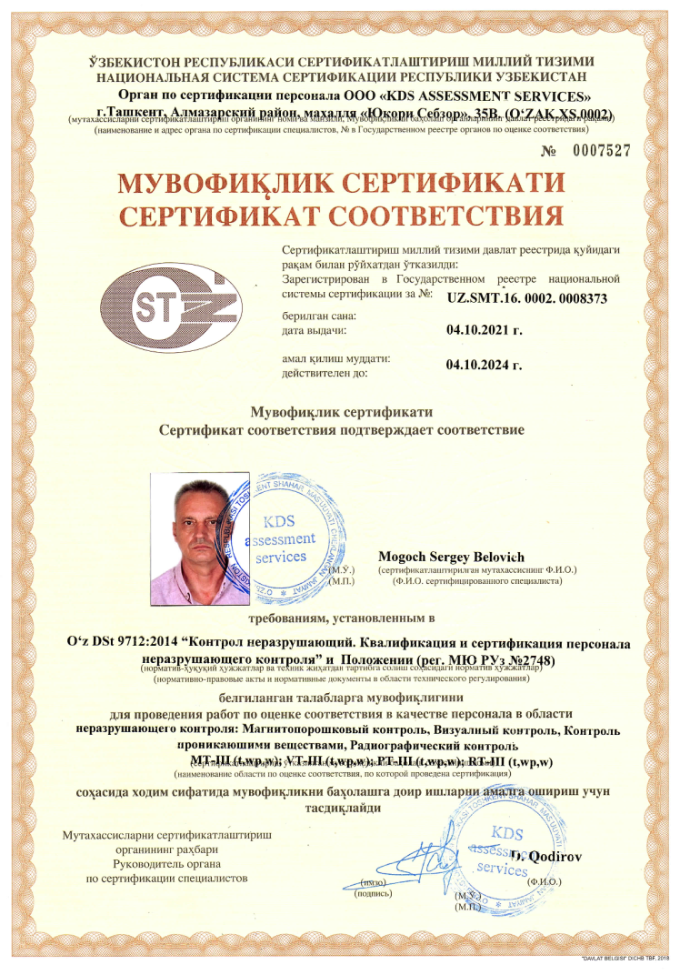
9. Certification Status of Inspectors
UZ SMT
31

Slide 32
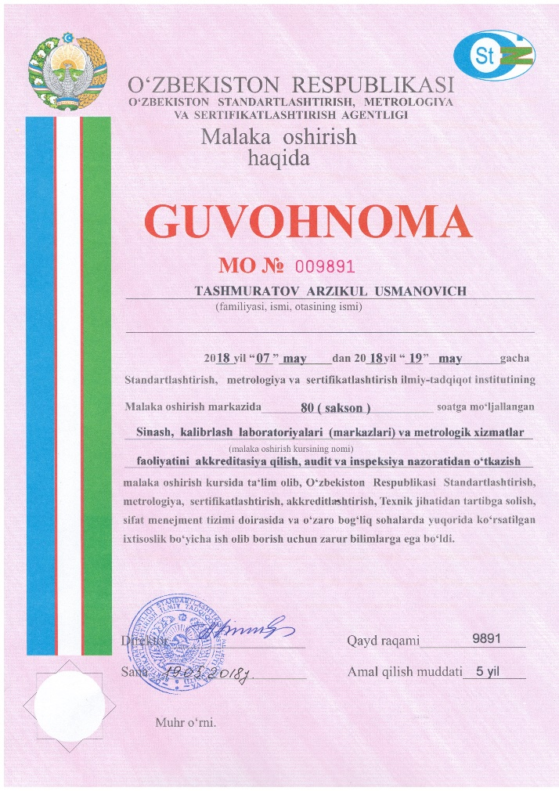
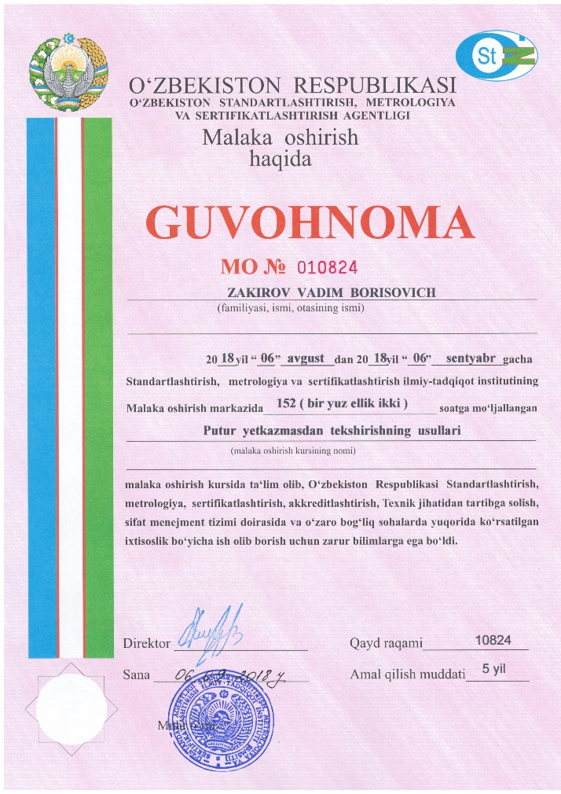
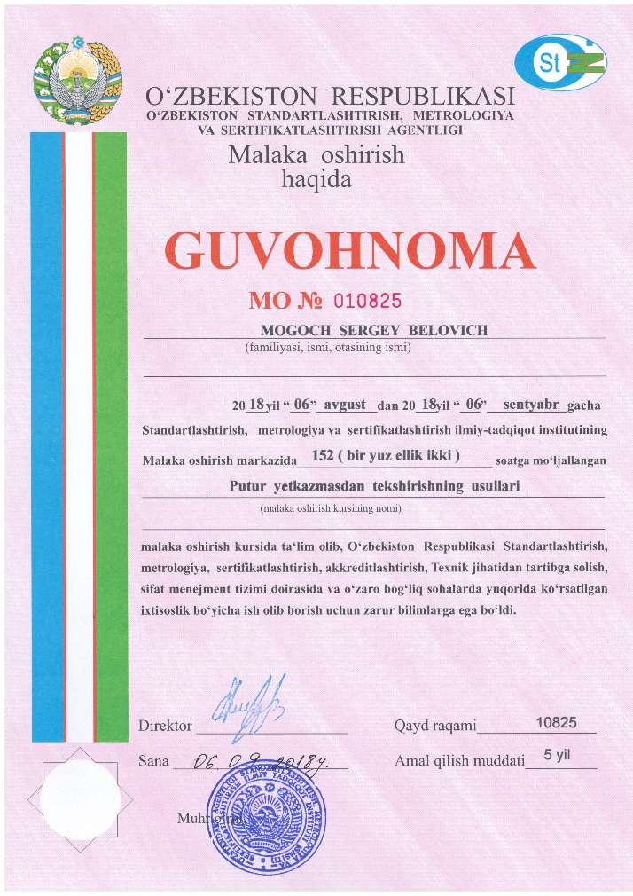
9. Certification Status of Inspectors
UZ SMT
32

Slide 33

9. Certification Status of Inspectors
AWS QC1
33

Slide 34
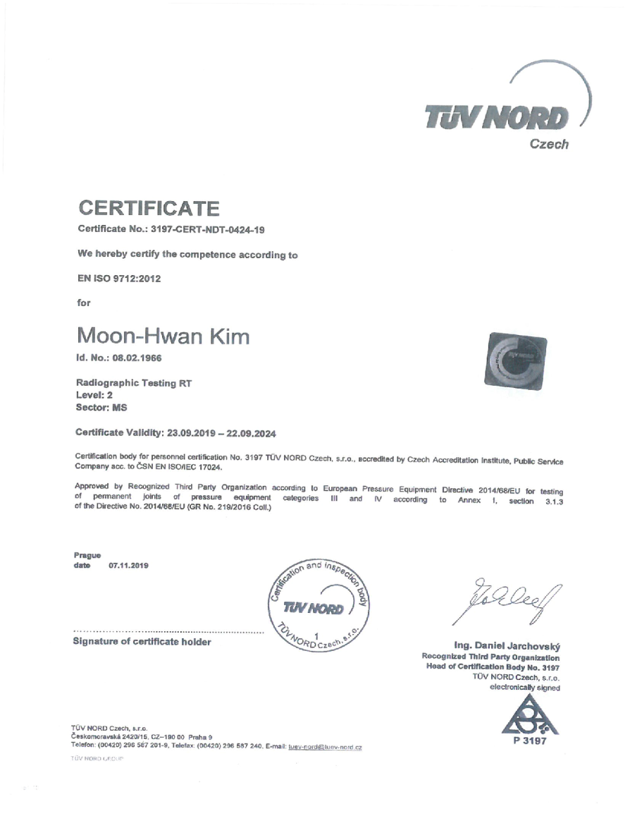
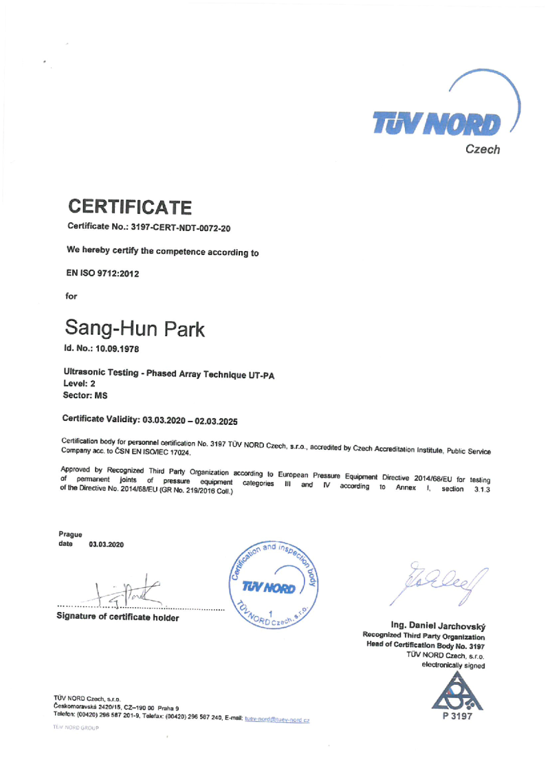
9. Certification Status of Inspectors
UT EN ISO 9712 (TOFD & PAUT)
RT EN ISO 9712 (TOFD & PAUT)
34

Slide 35
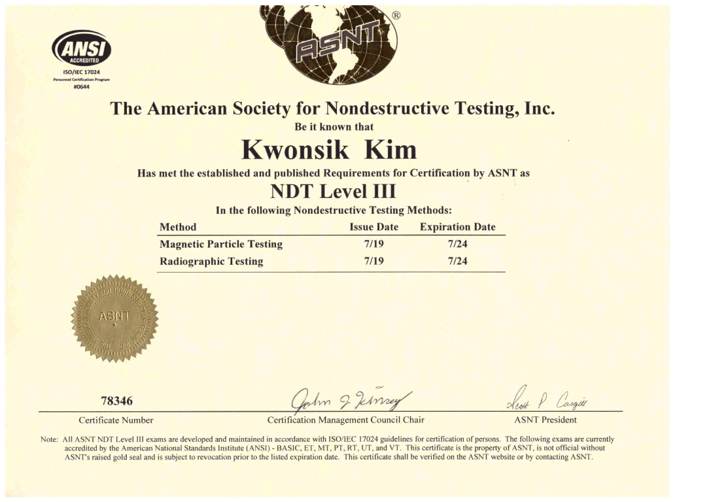
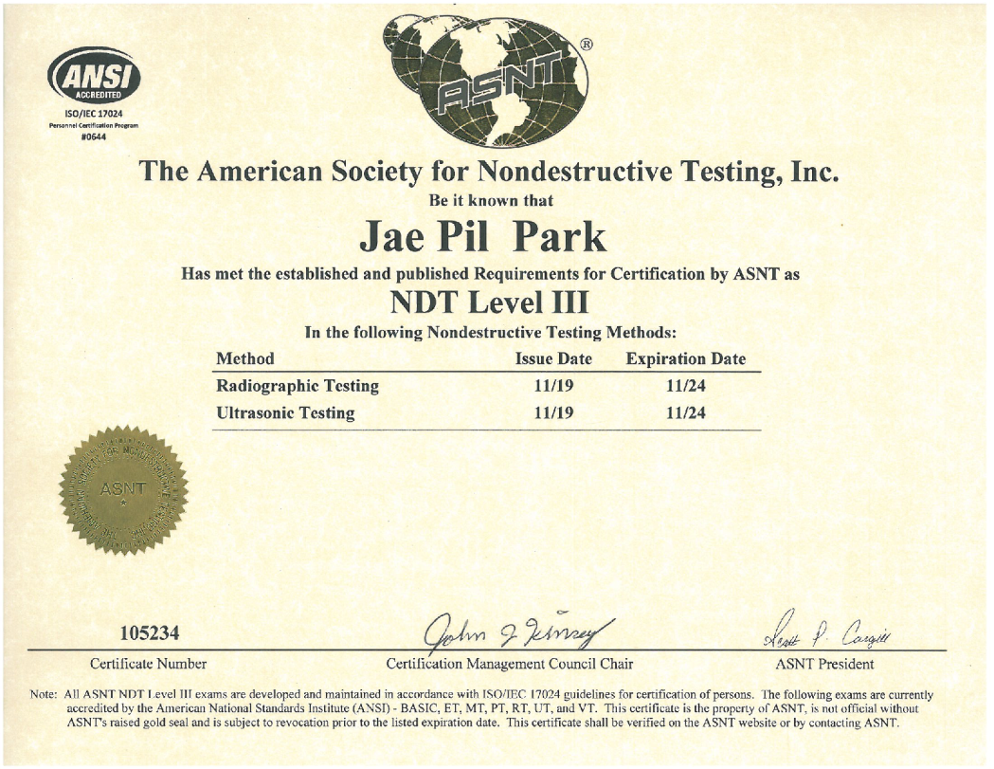
9. Certification Status of Inspectors
ASNT(DINE)
35

Slide 36
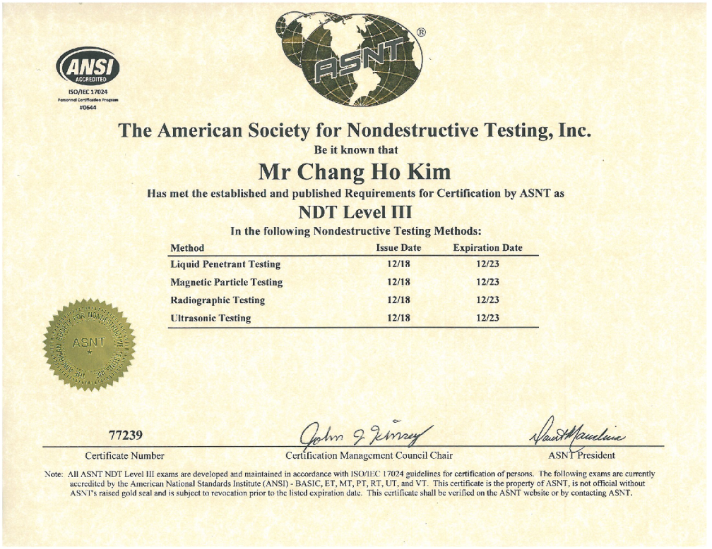
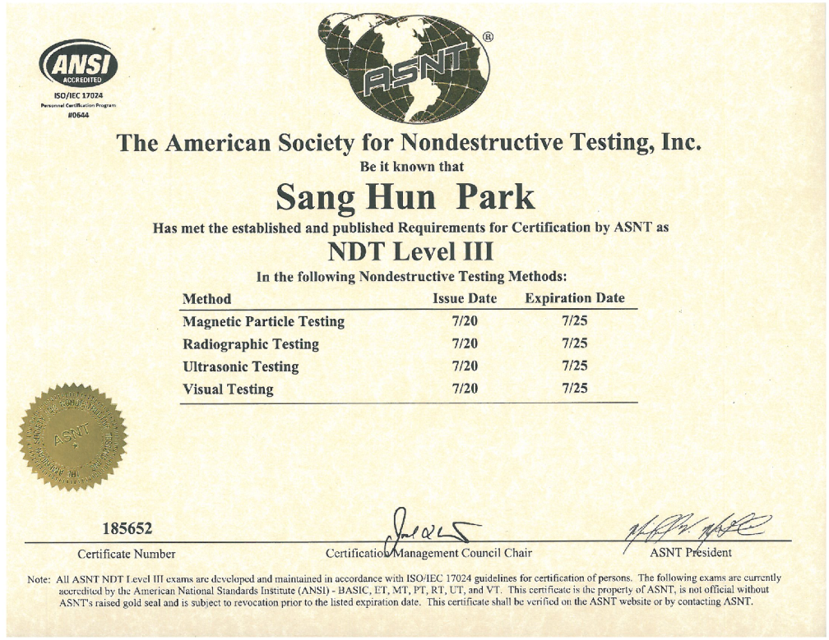
9. Certification Status of Inspectors
ASNT (SYMITech)
36

Slide 37
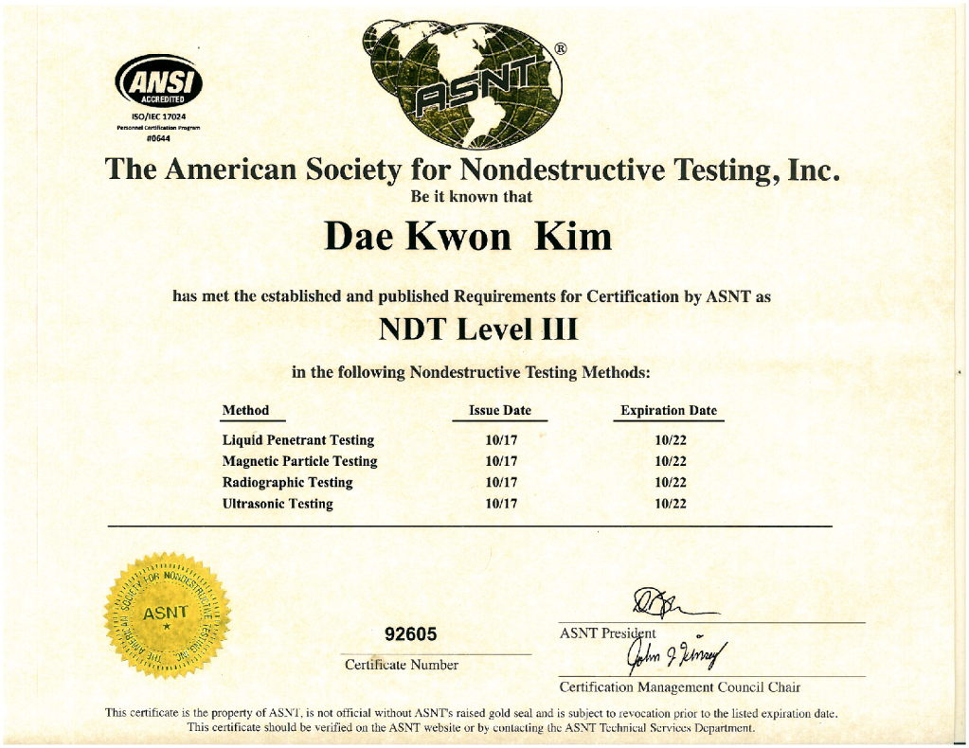
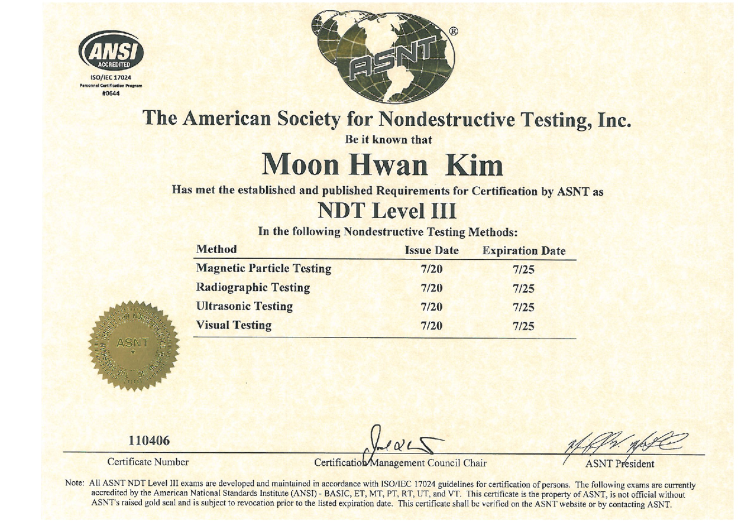
9. Certification Status of Inspectors
ASNT (SYMITech)
37

Slide 38
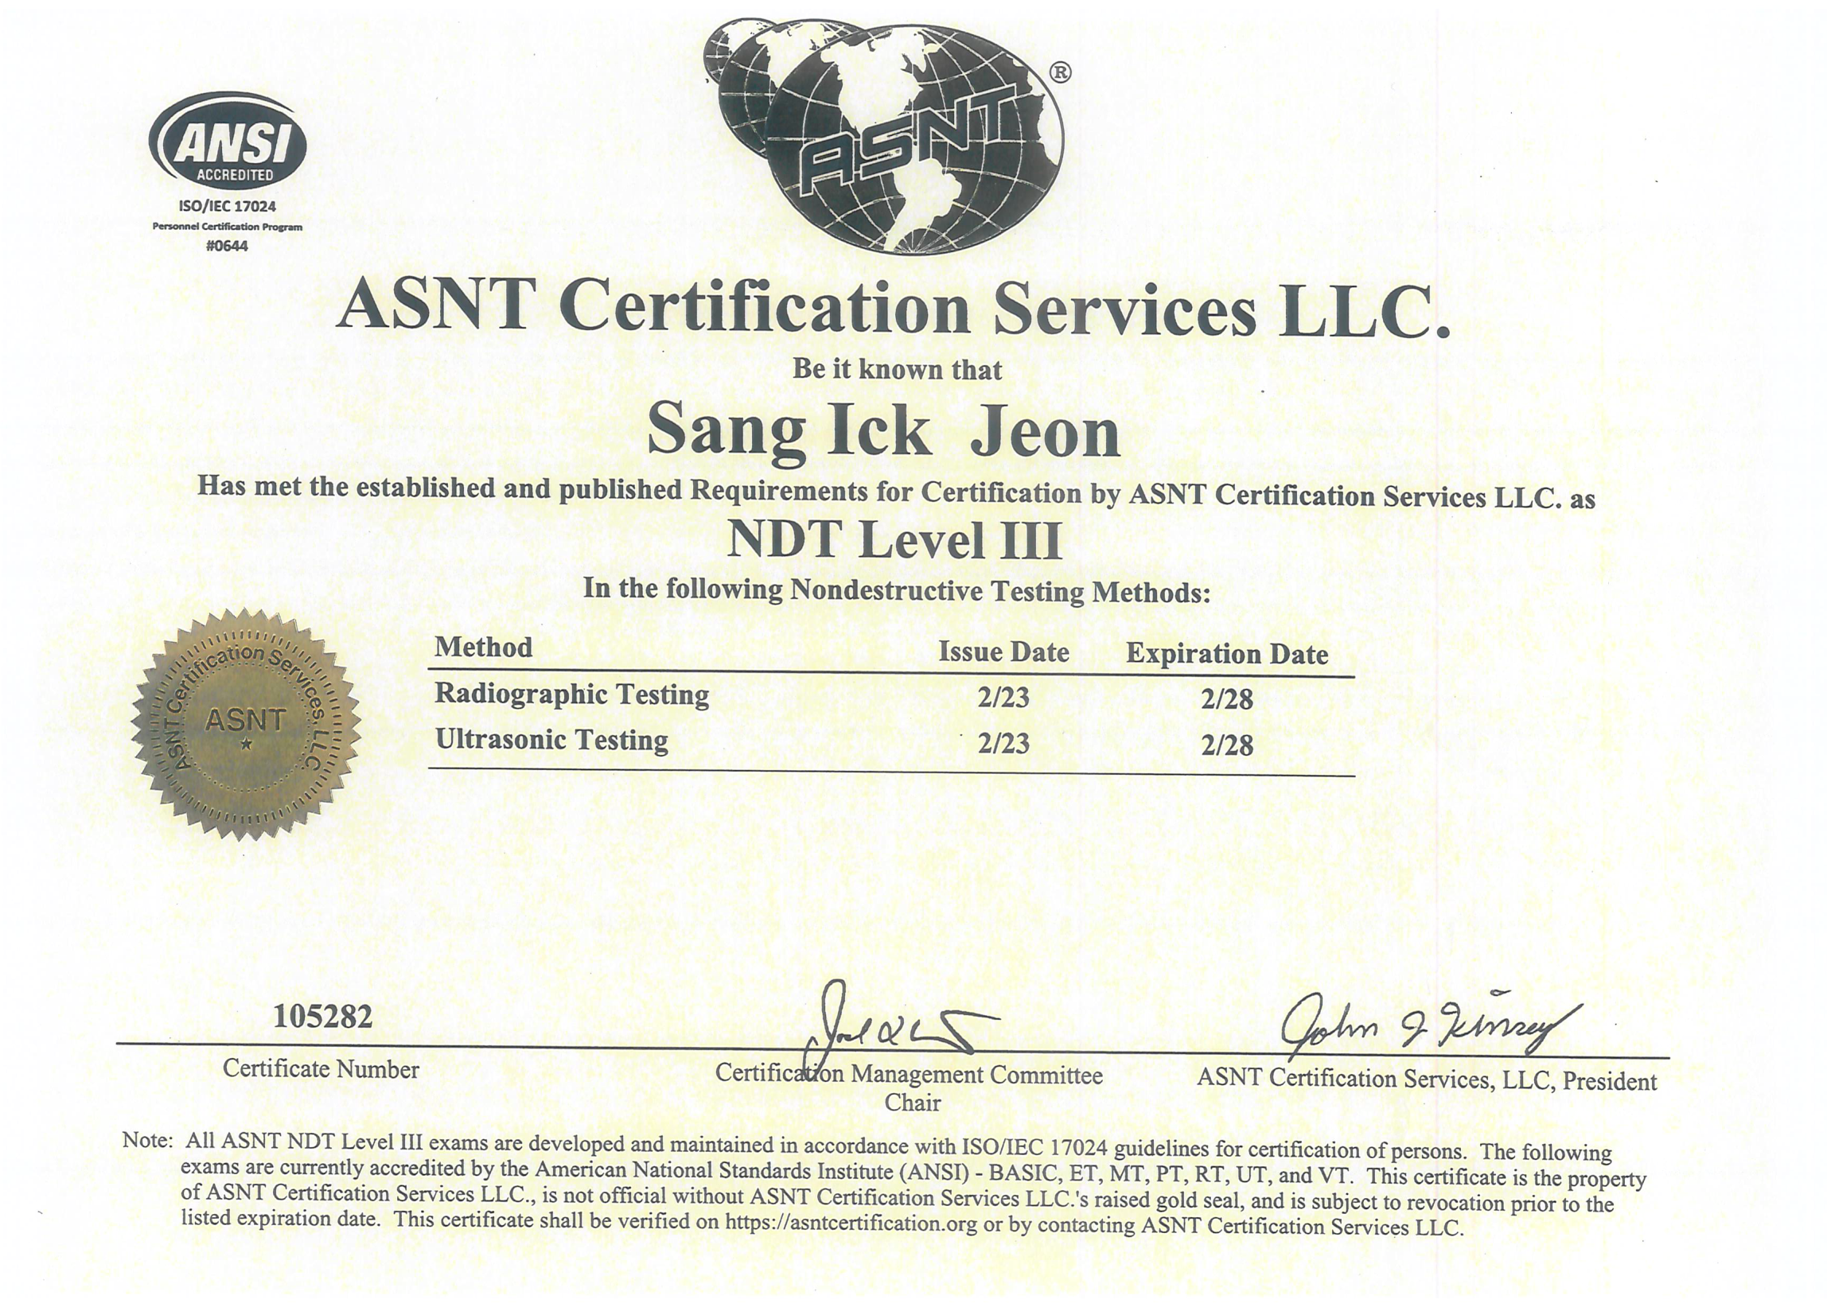
9. Certification Status of Inspectors
ASNT
38

Slide 39
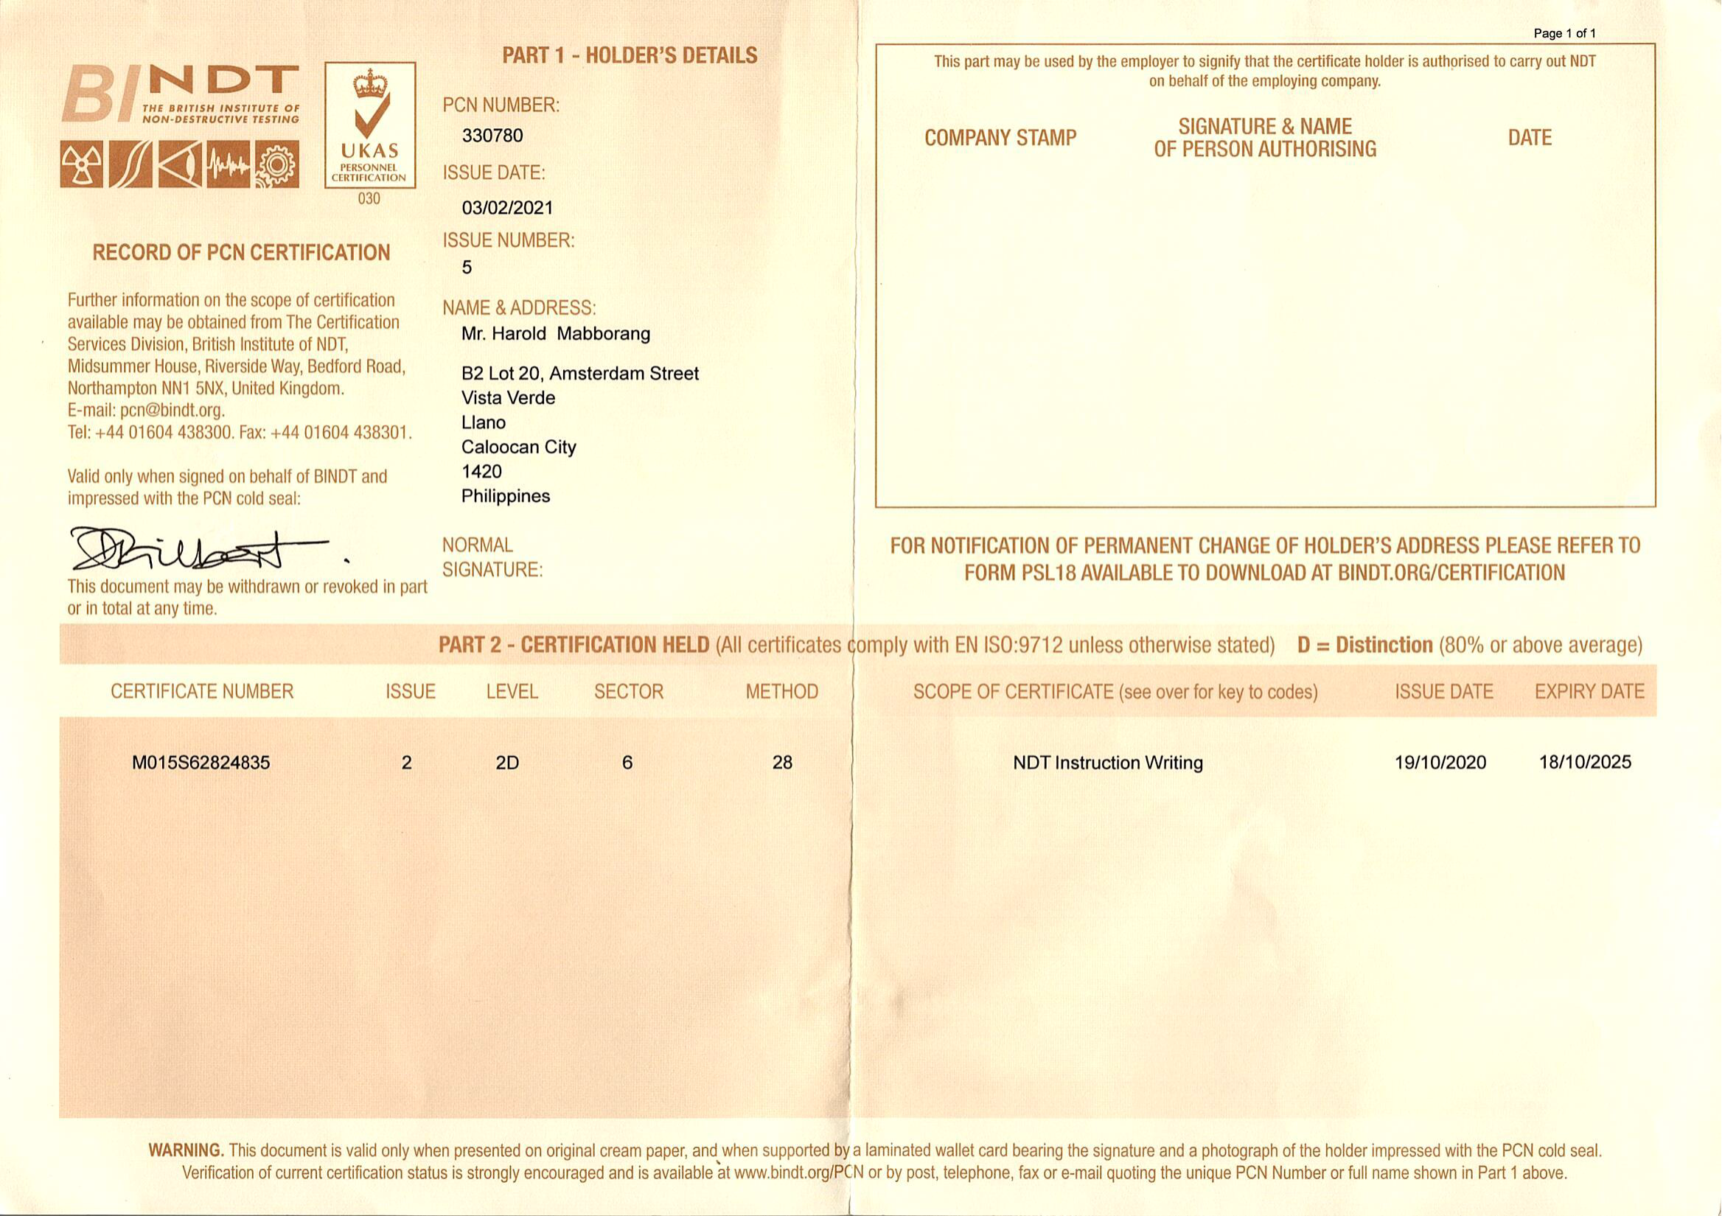
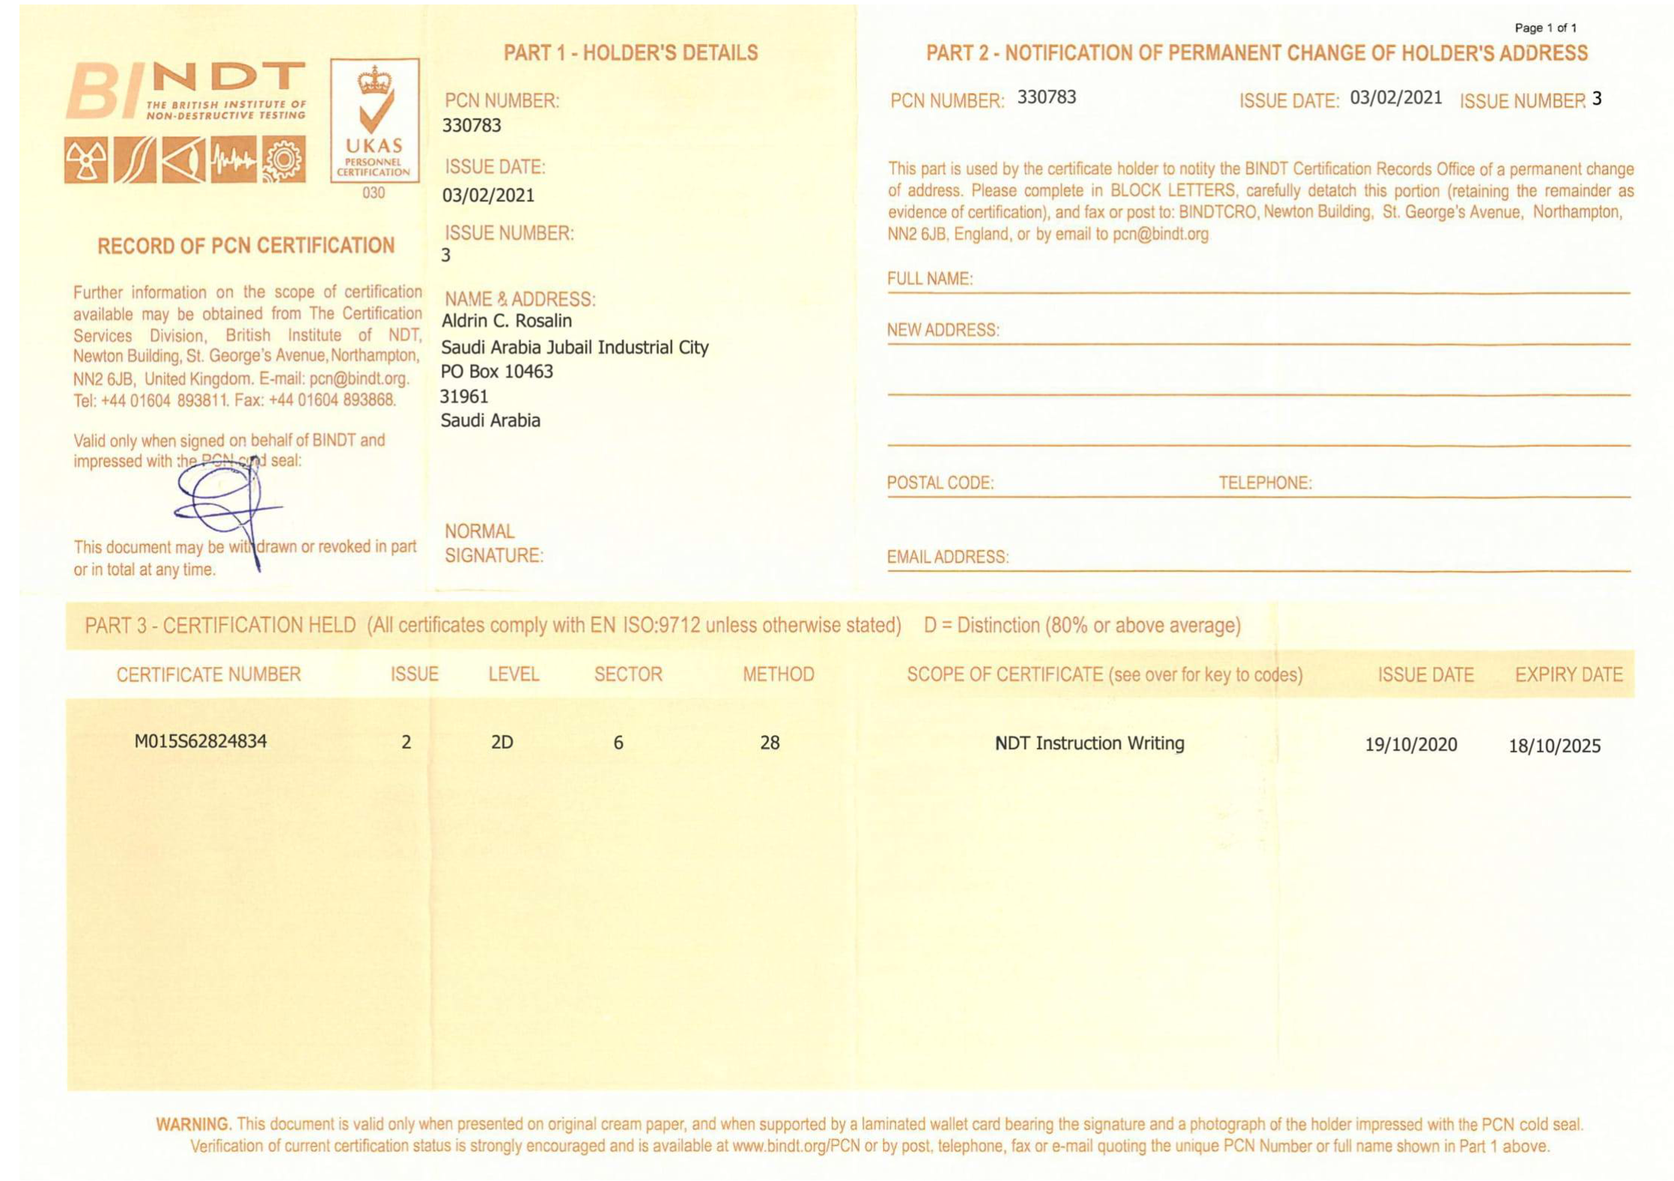
9. Certification Status of Inspectors
PAUT

Slide 40
10. Training & Certification (SYMITech)
NDT education is a qualification course according to SYMIT-QNC-H001 established on the basis of SNT-TC-1A and NAS410. After completion of the training, the person will be eligible for Level 1 or Level 2.
Education
& Training
  Compliant with SNT-TC-1A or NAS410 minimum requirements
Career Check
  Compliant with SNT-TC-1A or NAS410 minimum requirements
Examination
  NDT Methods (General, Specific, Practical)
Issue Certification
  Qualify with Level Ⅰ and Ⅱ (Technical Personnel)
40

Slide 41
Daesan NDE
International Engineering Co., Ltd
62-20, Sergeli 7, Sergeli district, Tashkent city, Uzbekistan | Tel: +998-90-941-4093 | https://daesannde.com

